Slide 1
Samsung
Innovation
Campus
Artificial Intelligence Course

Slide 2
Chapter 4.
Probability and Statistics
AI Course

Slide 3
Chapter Description
Chapter objectives
Be able to make probabilistic assessment.
Be able to carry out descriptive statistics and exploratory data analysis.
Be able to apply hypothesis testing.
Chapter contents
Unit 1. Understanding of Probability
Unit 2. Understanding of Statistics I
Unit 3. Understanding of Statistics II
Unit 4. Statistical Hypothesis Testing

Slide 4
Unit 1.
Understanding of Probability
1.1. Probability Theory
1.2. Probability Rules
1.3. Random Variable
1.4. Discrete Probability Distribution

Slide 5


1.1. Probability Theory
UNIT 01
Random Experiment and Event
Random experiment
Experiment where all possible outcomes can be observed.
It can be repeated as many times as possible under the exact same conditions.
The result or outcome is produced randomly.
Notes:
Some examples of random experiments are:
+Flipping a coin.
+Rolling dices.
You will start with these simple examples and build a basis of probability.

Slide 6
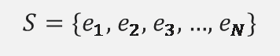
1.1. Probability Theory
UNIT 01
Sample space
Suppose that the possible outcomes of a random experiment are $e_{1}$, $e_{2}$, $e_{3}$, …, $e_{N}$.
You denote the sample space of the random experiment by S. This can be expressed as a set.
$$S=\{e_{1}\text{, }e_{2}\text{,} e_{3}\text{, …, }e_{N}\}$$
Ex
Rolling a dice, $S = \{1, 2, 3, 4, 5, 6\}$.
Ex
Flipping a coin, $S = \{T, H\}$ where T = tail and H = head.
Notes:
Here, you can define a sample space which is an important concept.
The examples shown here correspond to the finite sample spaces.
However, there can be also infinite sample spaces as you will see.

Slide 7
1.1. Probability Theory
UNIT 01
An event is a subset of the sample space.
Ex
The whole of $S$ → “total event”
Ex
Empty set $φ$ → “empty event”
Ex
Subsets composed of individual elements of $S$: $\{e_{1}\}$ , $\{e_{2}\}$ , … → “elementary events”
Ex
Other subsets: $\{e_{1},e_{2}\}$ , $\left\{e_{7},e_{9},e_{13}\right\}$ , …
Notes:
You can carry on with the set notation to define the events.
An event is a subset of the sample space.
You can combine the individual elements of the sample space to represent new events.

Slide 8
1.1. Probability Theory
UNIT 01
Events of rolling a dice
Sample space: $S=\{1, 2, 3, 4, 5, 6\}$
Ex
Event of outcome three: $E_{1}=\{3\}$→ “Elementary event”
Ex
Event of outcome equal or larger than three: $A=\{3, 4, 5, 6\}$
Ex
Event of odd outcome: $O=\{1, 3, 5\}$
Ex
Event of even outcome: $E=\{2, 4, 6\}$
Ex
Event of even outcome that is equal or larger than three: $A∩E=\left\{4, 6\right\}$
Ex
Event of even outcome or outcome that is equal or larger than three: $A∪E=\{2, 3, 4, 5, 6\}$
Notes:
Here, you can see more examples of event from the “rolling a dice” random experiment.
Set intersection is used when you combine different events with AND.
Set union is used when you combine events with OR.

Slide 9
1.1. Probability Theory
UNIT 01
Events of rolling a dice (continued)
Ex
We notice that $E∩O=φ$→ “𝐸 and 𝑂 are mutually exclusive events.”
Ex
Event of even outcome that is not equal or larger than three: $E−A=\{2\}$
Ex
Event of outcome equal or larger than three that is not even: $A−E=\{3, 5\}$
Ex
Event of outcome that is not equal or larger than three: $A^{c}=S−A=\left\{1, 2\right\}$ → “Complementary event”
Notes:
Sometimes it is useful to consider the complementary events.
We will cover more about this when you calculate the probabilities later on.

Slide 10
1.1. Probability Theory
UNIT 01
Events of flipping two coins: one dime (10 cents) and one quarter (25 cents)
Sample space: $S=\left\{\left(H, H\right), \left(H,T\right), \left(T,H\right),\left(T,T\right)\right\}$
Ex
Event of both coins showing the tail side: $E_{1}=\left\{\left(T,T\right)\right\}$
Ex
Event of both coins showing the same side: $E_{2}=\left\{\left(H, H\right), \left(T,T\right)\right\}$
Ex
Event of at least one coin showing the tail side: $E_{3}=\left\{\left(T, T\right), \left(T,H\right),\left(H,T\right)\right\}$
Notes:
The example on this slide corresponds to the flipping of two coins.
Please note that the elementary events are composed of pairs $\left(H, H\right), \left(H,T\right), \left(T,H\right),\left(T,T\right)$.

Slide 11
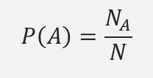
1.1. Probability Theory
UNIT 01
Definition of Probability
Mathematical definition of probability
Suppose that $N$ is the number of elementary events of the sample space.
Suppose that $N_{A}$ is the number of all possible outcomes corresponding to the event 𝐴.
$$P\left(A\right)=\frac{N_{A}}{N}$$
Notes:
Now, we will give probability a formal definition.
It basically boils down to counting the number of possible outcomes.

Slide 12
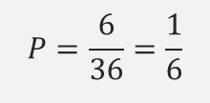
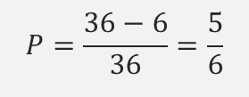
1.1. Probability Theory
UNIT 01
Probabilities of rolling two dices
Sample space: $S=\left\{\left(1, 1\right), \left(1,2\right), \left(1,3\right),…,\left(6,6\right)\right\}$, 𝑁=36
Ex
The probability of dices showing different numbers
$$P=\frac{36−6}{36}=\frac{5}{6}$$
Ex
The probability of dices showing numbers that sum up to 7
The event we are interested in is $A=\left\{\text{(1,6), (2,5), (3,4), (4,3), (5,2), (6,1)}\right\}$. So, $N_{A}$=6.
$$P=\frac{6}{36}=\frac{1}{6}$$
Notes:
The sample space for the “rolling two dices” has 36 elements.
This number goes in the denominator of the probability calculation.
In the numerator goes the count of all the possible outcomes of the event.

Slide 13
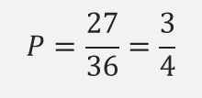
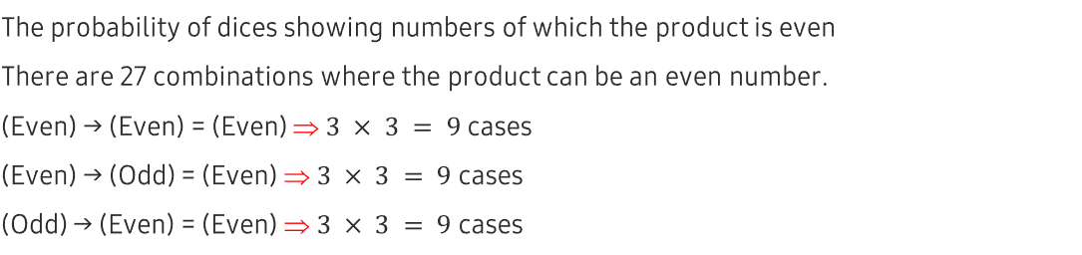
1.1. Probability Theory
UNIT 01
Probabilities of rolling two dices
Sample space: $S=\left\{\left(1, 1\right), \left(1,2\right), \left(1,3\right),…,\left(6,6\right)\right\}$, 𝑁=36
Ex
The probability of dices showing numbers of which the product is even
There are 27 combinations where the product can be an even number.
(Even) → (Even) = (Even) ⇒ $3 × 3 = 9$ cases
(Even) → (Odd) = (Even) ⇒ $3 × 3 = 9$ cases
(Odd) → (Even) = (Even) ⇒ $3 × 3 = 9$ cases
27 in total
$$P=\frac{27}{36}=\frac{3}{4}$$
Notes:
Another example of the “rolling of two dices” random experiment.
The number of possible outcomes of the event is 27 as explained here.
Unless you multiply an odd number by another odd number, the product of two numbers is even.

Slide 14

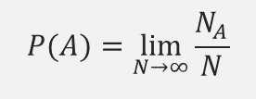
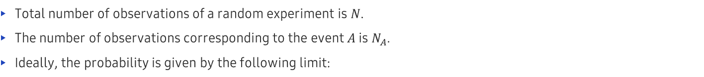
1.1. Probability Theory
UNIT 01
Statistical (empirical) definition of probability
Total number of observations of a random experiment is $N$.
The number of observations corresponding to the event $A$ is $N_{A}$.
Ideally, the probability is given by the following limit:
$$P(A)=\lim_{N→∞}{\frac{N_{A}}{N}}$$
However, the following is more realistic:
$$P\left(A\right)=\frac{N_{A}}{N}$$
Notes:
You can also define the empirical probability.
Ideally, you should take the limit of $N$ going to the infinity.
However, often you cannot take this limit for practical reasons.
So you may settle for a definition using a finite value of $N$.

Slide 15
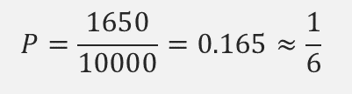
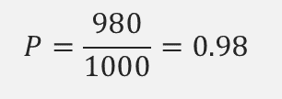
1.1. Probability Theory
UNIT 01
Statistical (empirical) definition of probability
Ex
According to the data, out of 1,000 newborns, 985 live beyond the first year.
What is the survival probability in one year?
$$P=\frac{980}{1000}=0.98$$
Ex
A dice was rolled 10,000 times out of which 1,650 times the outcome ‘one’ was obtained.
What is the probability of the outcome ‘one’?
$$P=\frac{1650}{10000}=0.165≈\frac{1}{6}$$
Notes:
Here, you can apply the empirical definition of probability from the previous page.

Slide 16
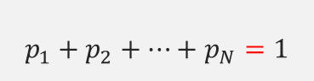
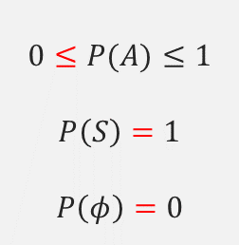
1.1. Probability Theory
UNIT 01
Theorems of Probability
For an arbitrary event 𝐴, sample space 𝑆 and empty event 𝜙:
$$0≤P(A)≤1$$
$$P\left(S\right)=1$$
$$P\left(φ\right)=0$$
Given the elementary events 𝑒_𝑖 and the corresponding probabilities 𝑝_𝑖, the “normalization” holds:
$$p_{1}+p_{2}+…+p_{N}=1$$
Notes:
These theorems show the fundamental properties that probability should satisfy.
1) Probability is bound by the limits 0 (lower) and 1 (upper).
2) The probabilities of the elementary events should sum up to 1, no more no less.

Slide 17
Unit 1.
Understanding of Probability
1.1. Probability Theory
1.2. Probability Rules
1.3. Random Variable
1.4. Discrete Probability Distribution

Slide 18
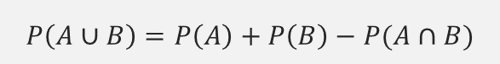
1.2. Probability Rules
UNIT 01
Probability Rules
Sum of probabilities
For arbitrary events 𝐴 and 𝐵:
$$P\left(A∪B\right)=P\left(A\right)+P\left(B\right)−P(A∩B)$$
“Sum rule”
A
B
Notes:
This rule corresponds to the situation when you want to combine the events A and B by an OR.
So, we are talking about the “A OR B” event and its probability.
In case the overlap $A∩B$ is not an empty set, you should subtract its probability $P(A∩B)$ in order to avoid double counting.

Slide 19
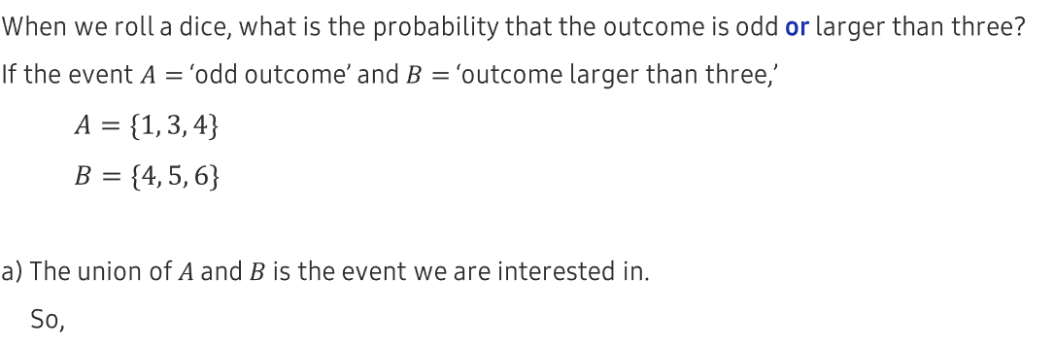
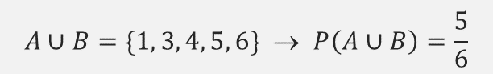
1.2. Probability Rules
UNIT 01
Sum of probabilities
Ex
When we roll a dice, what is the probability that the outcome is odd or larger than three?
If the event $A=$ ‘odd outcome’ and $B=$ ‘outcome larger than three,’
$A=\{1, 3, 4\}$
$B=\{4, 5, 6\}$
a) The union of $A$ and $B$ is the event we are interested in.
So,
$$A∪B=\{1, 3, 4, 5, 6\} \text{→ }P\left(A∪B\right)=\frac{5}{6}$$
Notes:
This example shows how to estimate the probability of the “A OR B” event.

Slide 20
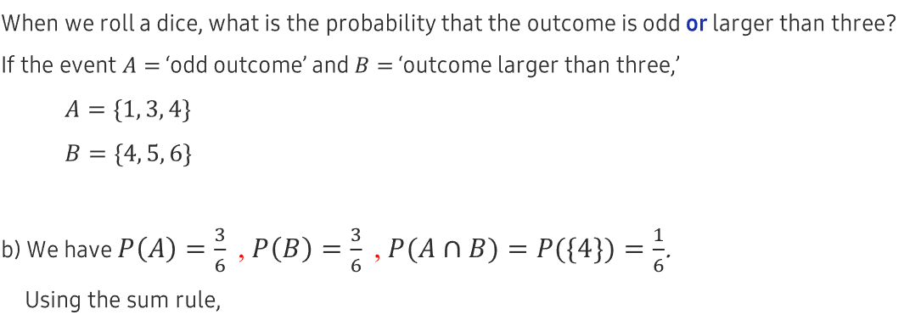
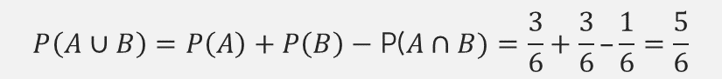
1.2. Probability Rules
UNIT 01
Sum of probabilities
Ex
When we roll a dice, what is the probability that the outcome is odd or larger than three?
If the event $A=$ ‘odd outcome’ and $B=$ ‘outcome larger than three,’
$A=\{1, 3, 4\}$
$B=\{4, 5, 6\}$
b) We have $P\left(A\right)=\frac{3}{6} \text{,} P\left(B\right)=\frac{3}{6} \text{,} P(A∩B)=P(\{4\})=\frac{1}{6}$.
Using the sum rule,
$$P\left(A∪B\right)=P\left(A\right)+P\left(B\right)−\text{P}\text{(}A∩B)=\frac{3}{6}+\frac{3}{6}–\frac{1}{6}=\frac{5}{6}$$
Notes:
Please note that the overlap $A∩B$ is not an empty set. So, you should subtract its corresponding probability.
You could have arrived at the same result by simply considering the outcomes that are odd number OR larger than three.
The corresponding set would be $\left\{1, 3, 4, 5, 6\right\}$ which has 5 elements.
So the result is 5 out of 6, that is 5/6.

Slide 21
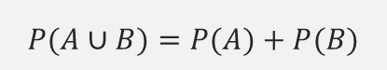
1.2. Probability Rules
UNIT 01
Sum of probabilities
If the events 𝐴 and 𝐶 are mutually exclusive (“𝐴∩𝐵=𝜙”):
$$P(A∪B)=P(A)+P(B)$$
A
B
Notes:
When two events have no overlap $A∩B=φ$, we say that they are mutually exclusive.
When there is no overlap between the events A and B, the sum of probabilities becomes much simpler to calculate.

Slide 22
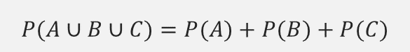
1.2. Probability Rules
UNIT 01
Sum of probabilities
If the events 𝐴, 𝐵, and 𝐶 are mutually exclusive (“𝐴∩𝐵=𝜙," "𝐴∩𝐶=𝜙," "𝐵∩𝐶=𝜙”):
$$P(A∪B∪C)=P(A)+P(B)+P(C)$$
A
B
C
Notes:
Similar rules apply for the case of three events.
The sum of probabilities become much easier when the events are mutually exclusive pairwise.

Slide 23
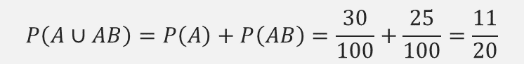
1.2. Probability Rules
UNIT 01
Sum of probabilities
Ex
Out of 100 people, 30 are of blood type A, 28 of B, 17 of O, and 25 of AB.
If we randomly pick one person, what is the probability of that person’s blood type being A or AB?
a) Blood types are mutually exclusive events.
So,
$$P\left(A∪AB\right)=P\left(A\right)+P\left(AB\right)=\frac{30}{100}+\frac{25}{100}=\frac{11}{20}$$
Notes:
The occurrences of blood type are mutually exclusive events, as no one can have two different blood types.
Using the probability sum rule, we can easily answer the question.

Slide 24
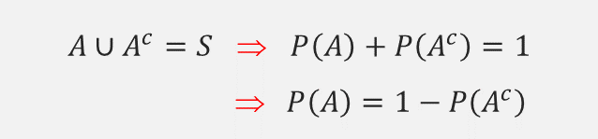

1.2. Probability Rules
UNIT 01
Complementary events
For an event $A$ and its complementary event $A^{c}$, the following relation holds:
$$A∪A^{c}=S \text{⇒} P\left(A\right)+P\left(A^{c}\right)=1$$
$$\text{ }P\left(A\right)=1−P\left(A^{c}\right)$$
$$S$$
$$A^{c}$$
A
Notes:
A complementary event can be mapped conveniently to the complementary set.

Slide 25
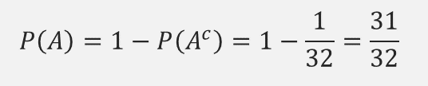
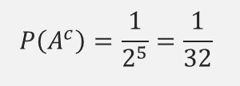

1.2. Probability Rules
UNIT 01
Complementary events
Ex
When we flip five coins, what is the probability that at least one comes out head?
a) If the event 𝐴= ‘at least one coin comes out head,’ its complementary is
$A^{c}$= ‘all the coins come out tail.’
Thus,
$$P\left(A^{c}\right)=\frac{1}{2^{5}}=\frac{1}{32}$$
b) Between the event and its complementary, we have 𝑃(𝐴)+𝑃(𝐴^𝑐 )=1.
So,
$$P\left(A\right)=1−P\left(A^{c}\right)=1−\frac{1}{32}=\frac{31}{32}$$
Notes:
Sometimes, it is much easier to calculate the probability of the complementary event than that of the event itself.
So, in this example you calculate the probability of the complementary event first.
Then, using the simple relation $P\left(A\right)=1−P\left(A^{c}\right)$, you obtain the probability of the event itself.

Slide 26
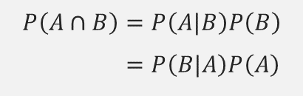
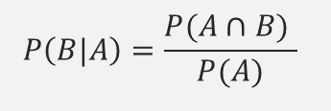
1.2. Probability Rules
UNIT 01
Complementary events
Suppose that you have the events 𝐴 and 𝐵 of which probabilities are non-zero.
The probability of the 𝐵 conditional on the 𝐴 is denoted by 𝑃(𝐵|𝐴).
The following relation holds among the probabilities.
A
B
$$P\left(B|A\right)=\frac{P(A∩B) }{P(A)}$$
We can also rearrange the above relation as following.
$$P\left(A∩B\right)=P\left(A|B\right)P\left(B\right)$$
$$=P\left(B|A\right)P\left(A\right)$$
Notes:
Now you move on to the next probability rule that connects the conditional probability $P\left(B|A\right)$ with the probability of overlap $P(A∩B)$.
You should be very careful here:
+Usually $P\left(B|A\right)≠P\left(A|B\right)$.
+But, $P\left(A∩B\right)=P\left(B∩A\right)$ always!

Slide 27
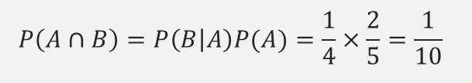
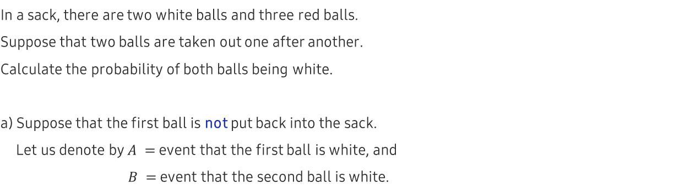
1.2. Probability Rules
UNIT 01
Conditional probability
Ex
In a sack, there are two white balls and three red balls.
Suppose that two balls are taken out one after another.
Calculate the probability of both balls being white.
a) Suppose that the first ball is not put back into the sack.
Let us denote by $A =$ event that the first ball is white, and
$B =$ event that the second ball is white.
$$P\left(A∩B\right)=P\left(B | A\right)P(A)=\frac{1}{4}×\frac{2}{5}=\frac{1}{10}$$
Notes:
When the first ball is not put back into the sack,
it matters what color this ball was when we calculate the probabilities of the second ball.
This causal relation is expressed using the conditional probability.

Slide 28
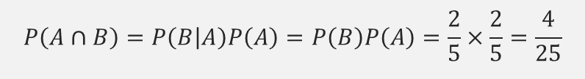
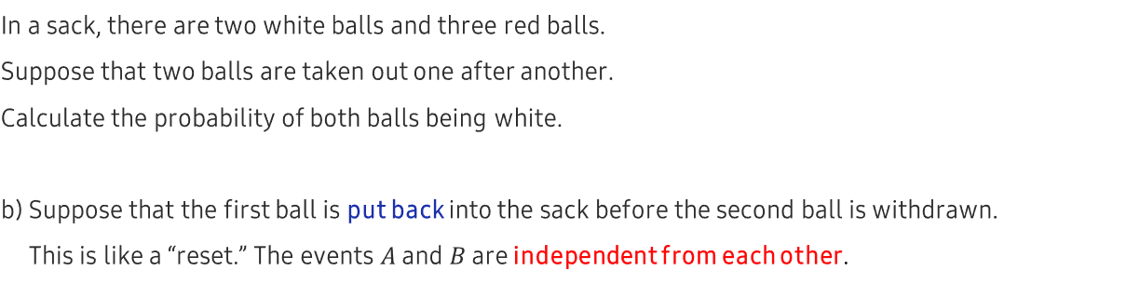
1.2. Probability Rules
UNIT 01
Conditional probability
Ex
In a sack, there are two white balls and three red balls.
Suppose that two balls are taken out one after another.
Calculate the probability of both balls being white.
b) Suppose that the first ball is put back into the sack before the second ball is withdrawn.
This is like a “reset.” The events $A$ and $B$ are independent from each other.
$$P\left(A∩B\right)=P\left(B | A\right)P\left(A\right)=P\left(B\right)P\left(A\right)=\frac{2}{5}×\frac{2}{5}=\frac{4}{25}$$
Notes:
When the first ball is put back into the sack, the causal connection is lost.
So, the conditional probability is no more required.
Withdrawing of the first ball and withdrawing of the second ball become completely independent events.

Slide 29
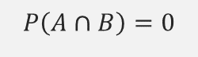
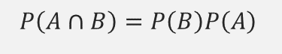
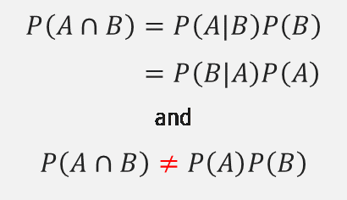
1.2. Probability Rules
UNIT 01
For the given events 𝐴 and 𝐵, you can think of the following cases.
1) If the events $A$ and $B$ are dependent on each other, then:
$$P\left(A∩B\right)=P\left(A|B\right)P\left(B\right)$$
$$=P\left(B|A\right)P\left(A\right)$$
$$\text{and}$$
$$P\left(A∩B\right)≠P\left(A\right)P\left(B\right)$$
2) If the events $A$ and $B$ are independent from each other, then:
$$P\left(A∩B\right)=P\left(B\right)P\left(A\right)$$
3) If the events $A$ and $B$ are mutually exclusive, then:
$$P\left(A∩B\right)=0$$
Notes:
You should clarify some of the terminologies.
Let us not confuse the mutual exclusivity with the independence.
They are completely different concepts.

Slide 30
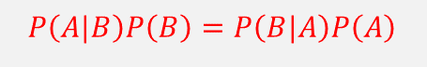
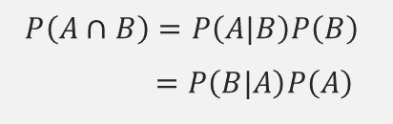
1.2. Probability Rules
UNIT 01
Bayes’ Theorem
Let us remember the following relation:
$$P\left(A∩B\right)=P\left(A|B\right)P\left(B\right)$$
$$=P\left(B|A\right)P\left(A\right)$$
Using the above relation, we can state the so-called Bayes’ theorem.
$$P\left(A|B\right)P\left(B\right)=P\left(B|A\right)P\left(A\right)$$
Notes:
Here is stated the so-called Bayes’ theorem.
It looks quite simple, however there is a large number of consequences from this.
There is a branch of statistics called “Bayesian statistics.”

Slide 31
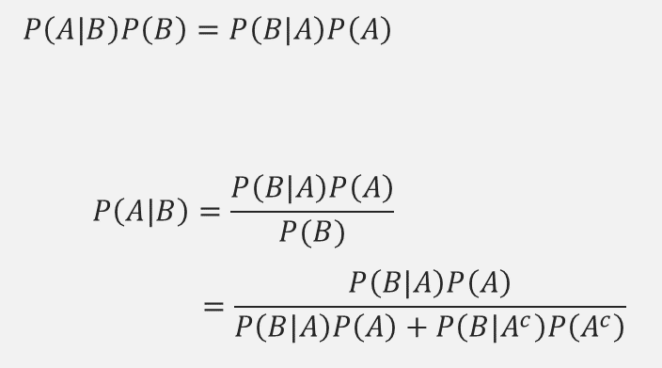
1.2. Probability Rules
UNIT 01
We may transform the Bayes’ theorem in the following way:
$$P\left(A|B\right)P\left(B\right)=P\left(B|A\right)P\left(A\right)$$
$$P\left(A|B\right)=\frac{P\left(B|A\right)P\left(A\right)}{P(B)}$$
$$=\frac{P\left(B|A\right)P\left(A\right)}{P\left(B|A\right)P\left(A\right)+P\left(B|A^{c}\right)P\left(A^{c}\right)}$$
Notes:
Here we transformed the Bayes’ theorem into a more “usable” format.
Please, pay close attention to the denominator.
Why not just calculate the $P(B)$ for the denominator without going through all this trouble?
Because, you cannot!
More explanation is to follow in the next slides.

Slide 32
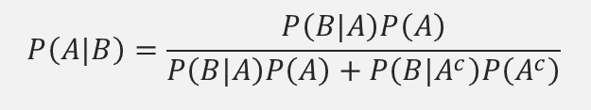
1.2. Probability Rules
UNIT 01
We may transform the Bayes’ theorem in the following way:
$$P\left(A|B\right)=\frac{P\left(B|A\right)P\left(A\right)}{P\left(B|A\right)P\left(A\right)+P\left(B|A^{c}\right)P\left(A^{c}\right)}$$
Notes:
Here we transformed the Bayes’ theorem into a more “usable” format.
Please, pay close attention to the denominator.

Slide 33
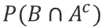
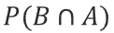

1.2. Probability Rules
UNIT 01
We may transform the Bayes’ theorem in the following way:
$$P\left(A|B\right)=\frac{P\left(B|A\right)P\left(A\right)}{P\left(B|A\right)P\left(A\right)+P\left(B|A^{c}\right)P\left(A^{c}\right)}$$
$$A^{c}$$
$$A^{c}$$
A
B
A
B
$$P(B∩A)$$
$$P(B∩A^{c})$$
Notes:
Here, each piece of the denominator is explained.
The $P(B)$ cannot be calculated otherwise because the event B may depend on the event A.
The only way to estimate $P(B)$ correctly is to consider separately the $P(B∩A)$ and $P(B∩A^{c})$.

Slide 34

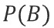
1.2. Probability Rules
UNIT 01
We may transform the Bayes’ theorem in the following way:
$$P\left(A|B\right)=\frac{P\left(B|A\right)P\left(A\right)}{P\left(B|A\right)P\left(A\right)+P\left(B|A^{c}\right)P\left(A^{c}\right)}$$
$$A^{c}$$
A
B
$$P(B)$$
Notes:
As it had been explained, the expression in the denominator is required to calculate the $P(B)$ correctly.

Slide 35
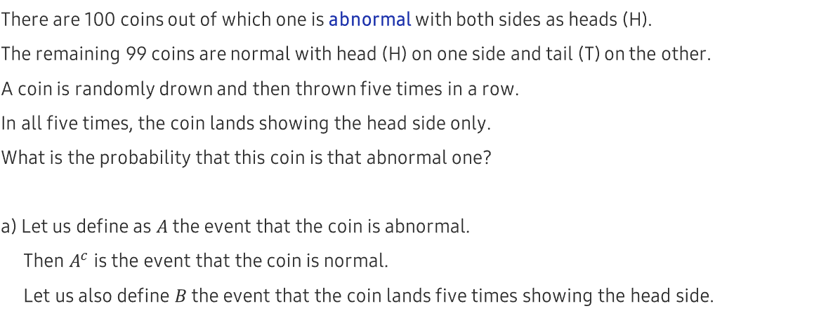
1.2. Probability Rules
UNIT 01
Bayes’ theorem example
Ex
There are 100 coins out of which one is abnormal with both sides as heads (H).
The remaining 99 coins are normal with head (H) on one side and tail (T) on the other.
A coin is randomly drown and then thrown five times in a row.
In all five times, the coin lands showing the head side only.
What is the probability that this coin is that abnormal one?
a) Let us define as $A$ the event that the coin is abnormal.
Then $A^{c}$ is the event that the coin is normal.
Let us also define $B$ the event that the coin lands five times showing the head side.
Notes:
An example that shows how the Bayes’ theorem can be applied in the real problems.

Slide 36
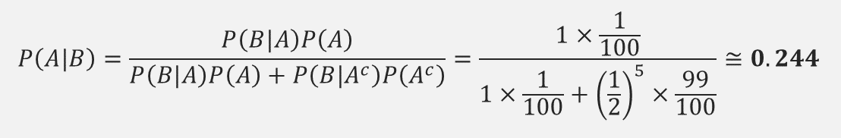
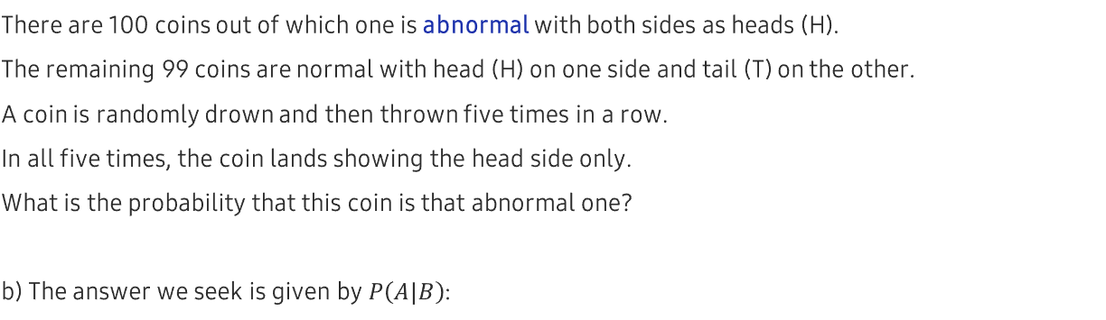
1.2. Probability Rules
UNIT 01
Bayes’ theorem example
Ex
There are 100 coins out of which one is abnormal with both sides as heads (H).
The remaining 99 coins are normal with head (H) on one side and tail (T) on the other.
A coin is randomly drown and then thrown five times in a row.
In all five times, the coin lands showing the head side only.
What is the probability that this coin is that abnormal one?
b) The answer we seek is given by $P\left(A|B\right)$:
$$P\left(A|B\right)=\frac{P\left(B|A\right)P\left(A\right)}{P\left(B|A\right)P\left(A\right)+P\left(B|A^{c}\right)P\left(A^{c}\right)}=\frac{1×\frac{1}{100}}{1×\frac{1}{100}+{\left(\frac{1}{2}\right)}^{5}×\frac{99}{100}}≅0.244$$
Notes:
Please note that the answer is not what you would expect “intuitively.”
Bayes’ theorem “mixes” the previous knowledge that only 1 out of 100 coins is abnormal with the data that only head side was shown in the five coin flips.

Slide 37
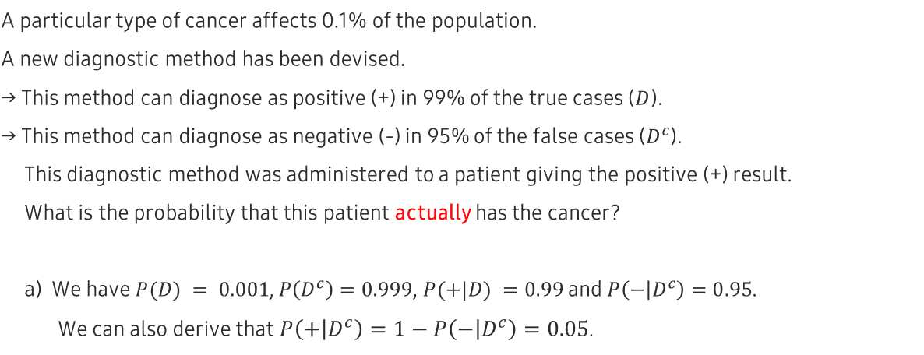
1.2. Probability Rules
UNIT 01
Bayes’ theorem example
Ex
A particular type of cancer affects 0.1% of the population.
A new diagnostic method has been devised.
→ This method can diagnose as positive (+) in 99% of the true cases ($D$).
→ This method can diagnose as negative (-) in 95% of the false cases ($D^{c}$).
This diagnostic method was administered to a patient giving the positive (+) result.
What is the probability that this patient actually has the cancer?
a) We have $P(D) = 0.001$, $P\left(D^{c}\right)=0.999$, $P(+|D) =0.99$ and $P\left(− | D^{c}\right)=0.95$.
We can also derive that $P\left(+ | D^{c}\right)=1−P\left(− | D^{c}\right)=0.05$.
Notes:
Another relevant example that shows a realistic application scenario of the Bayes’ theorem.
“Can diagnose as positive (+) in 99% of the true cases ($D$)” ⇒ in other words the sensitivity = 0.99
“Can diagnose as negative (-) in 95% of the false cases ($D^{c}$)” ⇒ in other words the specificity = 0.95

Slide 38
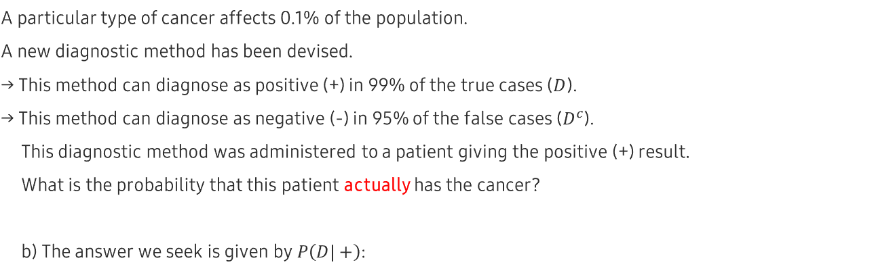
1.2. Probability Rules
UNIT 01
Bayes’ theorem example
Ex
A particular type of cancer affects 0.1% of the population.
A new diagnostic method has been devised.
→ This method can diagnose as positive (+) in 99% of the true cases ($D$).
→ This method can diagnose as negative (-) in 95% of the false cases ($D^{c}$).
This diagnostic method was administered to a patient giving the positive (+) result.
What is the probability that this patient actually has the cancer?
b) The answer we seek is given by $P\left(D|+\right)$:
$$P\left(D|+\right)=\frac{P\left(+|D\right)P\left(D\right)}{P\left(+|D\right)P\left(D\right)+P\left(+|D^{c}\right)P\left(D^{c}\right)}=\frac{0.99 × 0.001}{0.99 ×0.001+0.05×0.999}≅0.02$$
Notes:
Even when the sensitivity and specificity were “apparently” high, the probability $P\left(D|+\right)$ is surprisingly low!
Let us explain this a bit more “intuitively”:
The prior knowledge states that in general the probability of this disease is quite low at 0.1%.
In order to “overcome” this low occurrence rate, you may need a diagnostic method with higher sensitivity and specificity than given here.

Slide 39
Unit 1.
Understanding of Probability
1.1. Probability Theory
1.2. Probability Rules
1.3. Random Variable
1.4. Discrete Probability Distribution

Slide 40
1.3. Random Variable
UNIT 01
Random Variable
Random variable: a function that assigns a number to the outcome of a random experiment.
Ex
In a random experiment of coin flipping, assign 1 to the head (H) and assign 0 to the tail (T).
There are two types of random variables:
1) Discrete: for random experiments with a finite number of the possible outcomes.
Ex
Random variable that represents coin flipping experiment. Possible outcomes $=\left\{H, T\right\}$.
Ex
Random variable that represents dice rolling experiment. Possible outcomes $=\left\{1,2,3,4,5,6\right\}$.
2) Continuous: for random experiments with an infinite number of the possible outcomes.
Ex
Random variable that represents the heights of people.
Ex
Random variable that represents the wages of people.
Notes:
Here, random variable is defined.
Finite number of the possible outcomes = finite sample space.
Infinite number of the possible outcomes = infinite sample space.
You will see many more examples of the discrete as well as the continuous random variables.

Slide 41
1.3. Random Variable
UNIT 01
Discrete probability distribution function 𝑃(𝑥):
Maps the values of a discrete random variable to the corresponding probabilities.
You will denote in upper case a random variable and in lower case a particular value of it.
Ex
Given a random variable 𝑋, the probability of 𝑋 taking on a value 𝑥 is denoted by 𝑃(𝑋=𝑥) or 𝑃(𝑥).
Continuous probability density function 𝑓(𝑥):
When integrated, gives the interval probabilities. ⇐ More about this in the next unit.
Notes:
To describe the probabilistic properties of discrete random variables, we use the (discrete) probability distribution functions $P(x)$.
To describe the probabilistic properties of continuous random variables, we use the (continuous) probability density functions $f(x)$.

Slide 42
1.3. Random Variable
UNIT 01
Properties of discrete probability distribution
1) $0≤P(x)≤1$
2) $\sum_{all x_{i}}{P(x_{i})}=1$
Notes:
These properties put bounds on the possible values of the probabilities.

Slide 43
1.3. Random Variable
UNIT 01
Population and Sample
Population
The entirety of the data set is subject to the analysis.
It can be either “real” or “idealized.”
The properties of a population are called parameters.
Ex
Mean, standard deviation, variance, etc. of a population
Sample
It is a subset of the population.
The properties of a sample are called statistics.
Ex
Mean, standard deviation, variance, etc. of a sample
Notes:
A common question is “How large should a population be?”
Remember that the distinction of “population” vs “sample” is mostly conceptual.
Even when a data set is relatively “small”, if it represents the entirety then it qualifies as a “population.”

Slide 44
1.3. Random Variable
UNIT 01
We could calculate the mean, standard deviation, variance, etc. using a probability distribution function.
These quantities are properties of an “idealized” group.
They can be interpreted as parameters of an idealized population.
Notes:
The statistical properties of a population are called “parameters.”

Slide 45
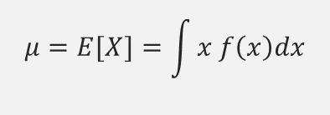
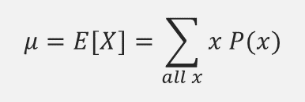
1.3. Random Variable
UNIT 01
Population Mean
Properties of the population mean
It is also called the expected value of a random variable: 𝐸[𝑋].
1) For the discrete case with $P(x)$= probability distribution function:
$$μ=E[X]=\sum_{all x}{x P(x)}$$
2) For the continues case with $f\left(x\right)$= probability density function:
$$μ=E[X]=\int{x f\left(x\right)dx}$$
Notes:
The population mean and the expected value of the random variable are the same.
For the discrete case, it is a weighted average using the probability as “weight.”
For the continuous case, we have to integrate instead of summing.

Slide 46
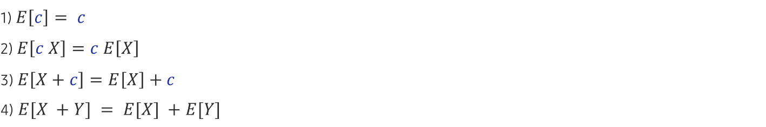
1.3. Random Variable
UNIT 01
Properties of the population mean
1) $E\left[c\right]= c$
2) $E\left[c X\right]=c E\left[X\right]$
3) $E\left[X+c\right]=E\left[X\right]+c$
4) $E[X +Y] = E[X] +E[Y]$
Note: $c$ stands for a constant.
Notes:
Here, $c$ stands for an arbitrary constant.
These relations are useful in simplifying the calculations.

Slide 47
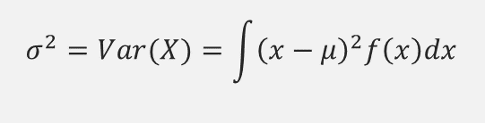
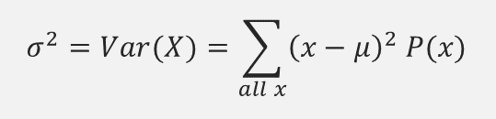
1.3. Random Variable
UNIT 01
Population Variance
The population variance is denoted by 𝜎^2 or 𝑉𝑎𝑟(𝑋).
1) For the discrete case with $P(x)$= probability distribution function:
$$σ^{2}=Var(X)=\sum_{all x}{{\left(x−μ\right)}^{2} P(x)}$$
2) For the continues case with $f\left(x\right)$= probability density function:
$$σ^{2}=Var(X)=\int{{\left(x−μ\right)}^{2}f\left(x\right)dx}$$
Note: In both cases, $σ^{2}=E\left[X^{2}\right]−{\left(E[X]\right)}^{2}$.
Note: The population standard deviation:$σ=\sqrt{σ^{2}}$.
Notes:
Here, you can define the population variance.
For the discrete case you do the sum.
For the continuous case you do the integral.

Slide 48
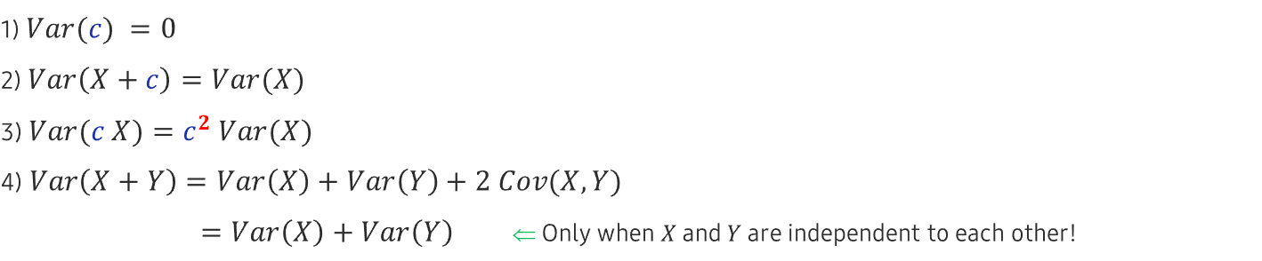
1.3. Random Variable
UNIT 01
Properties of the population variance
1) $Var(c) =0$
2) $Var\left(X+c\right)=Var(X)$
3) $Var(c X)=c^{2} Var(X)$
4) $Var\left(X+Y\right)=Var\left(X\right)+Var\left(Y\right)+2 Cov(X,Y)$
$=Var\left(X\right)+Var\left(Y\right)$ ⇐ Only when $X$ and $Y$ are independent to each other!
Note: $c$ stands for a constant.
Notes:
These relations are useful in simplifying the calculations.
Here, $c$ stands for an arbitrary constant.
When $c$ is summed to a random variable, it does not contribute to the variance.
When $c$ is multiplied to a random variable, it contributes as $c^{2}$ multiplied to the variance.
As for the variance of the sum of two random variables, you should distinguish whether these random variables are independent or not.

Slide 49
Unit 1.
Understanding of Probability
1.1. Probability Theory
1.2. Probability Rules
1.3. Random Variable
1.4. Discrete Probability Distribution

Slide 50

1.4. Discrete Probability Distribution
UNIT 01
Discrete Probability Distribution
Bernoulli random variable and probability distribution
Notes:
Flipping a single coin is an example of the Bernoulli random variable.

Slide 51

1.4. Discrete Probability Distribution
UNIT 01
Bernoulli random variable and probability distribution
Ex
Coin flipping
$\frac{1}{2}$
$\frac{1}{2}$
down
up
Notes:
For a coin flipping, the probabilities are the same (50%) for the head and tail outcomes.

Slide 52


1.4. Discrete Probability Distribution
UNIT 01
Bernoulli random variable and probability distribution
Ex
General binary outcome situation
$$p$$
$$(1−p)$$
0
1
Notes:
However, the Bernoulli random variable can be applied to any binary outcome situation.
The probabilities of the outcome sum up to 1 as you can easily check: $\left(1−p\right)+p=1$.

Slide 53

1.4. Discrete Probability Distribution
UNIT 01
Bernoulli random variable and probability distribution
1) “$X$ is a Bernoulli random variable.” ⇔ $X\sim B\text{er}\text{(}\text{p}\text{)}$
2) $P\left(x\right)=p^{x}{\left(1−p\right) }^{1−x}$
Mean = $p$
Variance = $p (1−p)$
Standard deviation = $\sqrt{p (1−p) }$
Notes:
In the probability distribution function $P\left(x\right)=p^{x}{\left(1−p\right) }^{1−x}$, $x$ can be either 0 or 1.
When $x=0$, you can see that $P\left(0\right)=p^{0}{\left(1−p\right) }^{1−0}=(1−p)$.
When $x=1$, you can see that $P\left(1\right)=p^{1}{\left(1−p\right) }^{1−1}=p$.

Slide 54

1.4. Discrete Probability Distribution
UNIT 01
Bernoulli random variable and probability distribution
Notes:
Flipping several coins is an example of the Binomial random variable.

Slide 55

1.4. Discrete Probability Distribution
UNIT 01
Bernoulli random variable and probability distribution
1) “$X$ is a Binomial random variable.” ⇔ $X\sim Bin\left(n,p\right)$
2) $X_{bin}=X_{Ber}+X_{Ber}+…+X_{Ber}$
← $n$ →
3) $P\left(x\right)=\left(\begin{matrix}n \\ x\end{matrix}\right)p^{x}{\left(1−p\right) }^{n−x}$ ⇐ $0≤x≤n$
Mean = 𝑛 𝑝
Variance = 𝑛 𝑝 (1−𝑝)
Standard deviation = $\sqrt{n p (1−p) }$
Notes:
More formally, a Binomial random variable is the sum of $n$ independent Bernoulli random variables.
The mean and the variance are those of the Bernoulli multiplied by $n$.

Slide 56

1.4. Discrete Probability Distribution
UNIT 01
Bernoulli random variable and probability distribution
$$n=10, p=0.5$$
0.3
0.2
0.1
0
0
2
4
6
8
10
Notes:
You have this shape for the Binomial probability distribution when $n = 10$and $p =0.5$.
Please note that the mean is $n×p=5$ coincident with the peak (the mode).

Slide 57

1.4. Discrete Probability Distribution
UNIT 01
Bernoulli random variable and probability distribution
$$n=10, p=0.3$$
0.3
0.2
0.1
0
0
2
4
6
8
10
Notes:
You have this shape for the Binomial probability distribution when $n = 10$and $p =0.3$.
Please note that the mean is $n×p=3$ coincident with the peak (the mode).

Slide 58

1.4. Discrete Probability Distribution
UNIT 01
Bernoulli random variable and probability distribution
$$n=10, p=0.7$$
0.3
0.2
0.1
0
0
2
4
6
8
10
Notes:
You have this shape for the Binomial probability distribution when $n = 10$and $p =0.7$.
Please note that the mean is $n×p=7$ coincident with the peak (the mode).

Slide 59

1.4. Discrete Probability Distribution
UNIT 01
Bernoulli random variable and probability distribution
Ex
It is known that the daily probability of raining is 20% for the following five days.
What is the probability of zero rainy day?
$$P\left(0\right)=\left(\begin{matrix}5 \\ 0\end{matrix}\right){0.2}^{0}{\left(1−0.2\right) }^{5−0}=\frac{5!}{0! 5!}{0.8}^{5}={0.8}^{5}=0.328$$
Notes:
You can model with the Binomial random variable when the result is a sum of binary outcomes.

Slide 60
1.4. Discrete Probability Distribution
UNIT 01
Bernoulli random variable and probability distribution
Ex
It is known that the daily probability of raining is 20% for the following five days.
What is the probability of exactly two rainy days?
$$P\left(2\right)=\left(\begin{matrix}5 \\ 2\end{matrix}\right){0.2}^{2}{\left(1−0.2\right) }^{5−2}=\frac{5!}{2!3!}{{ 0.2}^{2}×0.8}^{3}={10×{ 0.2}^{2}×0.8}^{3}=0.205$$
Notes:
You can model with the Binomial random variable when the result is a sum of binary outcomes.

Slide 61

1.4. Discrete Probability Distribution
UNIT 01
Bernoulli random variable and probability distribution
Ex
It is known that the daily probability of raining is 20% for the following five days.
What is the probability of two or fewer rainy days?
$$P\left(X≤2\right)=P\left(0\right)+P\left(1\right)+P\left(2\right)$$
$$=\left(\begin{matrix}5 \\ 0\end{matrix}\right){0.2}^{0}{\left(1−0.2\right) }^{5−0}+\left(\begin{matrix}5 \\ 1\end{matrix}\right){0.2}^{1}{\left(1−0.2\right) }^{5−1}+\left(\begin{matrix}5 \\ 2\end{matrix}\right){0.2}^{2}{\left(1−0.2\right) }^{5−2}$$
$$=1×1×{0.8}^{5}+5×0.2×{0.8}^{4}+10{×0.2}^{2}×{0.8}^{3}$$
$$=0.328+0.41+0.205$$
$$=0.942$$
Notes:
Not only can you calculate the probabilities for a given $x$, you can also calculate the probability of intervals: in this case $P\left(X≤2\right)$.

Slide 62
1.4. Discrete Probability Distribution
UNIT 01
Poisson random variable and probability distribution
It is named after the French scientist Simeon D. Poisson.
It describes the frequency of events for a given interval of time or space.
Ex
Number of emails received per hour
Ex
Number of earthquakes per year
Ex
Number of chocolate chips in a cookie
Notes:
Poisson random variable is another example of discrete random variable.

Slide 63

1.4. Discrete Probability Distribution
UNIT 01
Poisson random variable and probability distribution
1) “$X$ is a Poisson random variable.” ⇔ $X\sim Pois(λ)$
2) $P\left(x\right)=\frac{λ^{x}e^{−λ}}{x!}$ ⇐ $0≤x$
Mean = $$
Variance = $$
Standard deviation = $\sqrt{λ }$
3) By increasing $n$ while decreasing $p$, the Binomial distribution converges to the Poisson with $=n p$.
Notes:
Between the Binomial and the Poisson, there are similarities and differences.
a) Similarities:
+Both model the frequencies or counts.
+Both gives the probabilities for a given frequency $x$.
b) Differences:
+For the Binomial, there is an upper bound to the frequency: $0≤x≤n$
+For the Poisson, there is no upper bound to the frequency: $0≤x$
When $n$ becomes big while keeping $p$ small so that the upper bound becomes “irrelevant” then the Binomial “converges” to the Poisson.

Slide 64

1.4. Discrete Probability Distribution
UNIT 01
Poisson random variable and probability distribution
$$lambda=2$$
0.3
0.2
0.1
0
0
2
4
6
8
10
Notes:
You have this shape for the Poisson probability distribution when $λ=2$.
Please note that the mean is given by $λ=2$ close to the peak (the mode).

Slide 65

1.4. Discrete Probability Distribution
UNIT 01
Poisson random variable and probability distribution
$$lambda=4$$
0.3
0.2
0.1
0
0
2
4
6
8
10
Notes:
You have this shape for the Poisson probability distribution when $λ=4$.
Please note that the mean is given by $λ=4$ close to the peak (the mode).

Slide 66

1.4. Discrete Probability Distribution
UNIT 01
Poisson random variable and probability distribution
$$lambda=6$$
0.3
0.2
0.1
0
0
2
4
6
8
10
Notes:
You have this shape for the Poisson probability distribution when $λ=6$.
Please note that the mean is given by $λ=6$ close to the peak (the mode).

Slide 67


1.4. Discrete Probability Distribution
UNIT 01
Poisson random variable and probability distribution
Ex
During the last 100 days, 40 spam mails were received.
What is the probability that there will be zero spam mail tomorrow?
You can calculate that $λ=\frac{40}{100}=0.4$.
Then,
$$P\left(0\right)=\frac{{0.4}^{0}e^{−0.4}}{0!}=e^{−0.4}=0.6703$$
Notes:
Poisson random variable is useful to model the frequency of events for a given interval of time.

Slide 68

1.4. Discrete Probability Distribution
UNIT 01
Poisson random variable and probability distribution
Ex
During the last 100 days, 40 spam mails were received.
What is the probability that there will be more than one spam mails tomorrow?
You can calculate that $λ=\frac{40}{100}=0.4$.
Then, do $P\left(1\right)+P\left(2\right)+P\left(3\right)+…$ ??. ⇒ Hard!
Instead, you can calculate by doing $1−P(0) = 1−0.6703 = 0.3297$.
Notes:
Poisson random variable is useful to model the frequency of events for a given interval of time.
Here, instead of calculating directly the probability of the event (which is hard to do),
you calculate first the probability of the complementary event and then subtract it from 1.

Slide 69

1.4. Discrete Probability Distribution
UNIT 01
Coding Exercise #0201
Follow practice steps on 'ex_0201.ipynb’ file.
Notes:
WHAT THIS PRACTICE ABOUT
In this practice, you try out several functions of the SciPy library with regards to the discrete probabilities.
PRACTICE INSTRUCTION
Click Window button.
Search the “anaconda prompt” and Run.
Type the command "jupyter notebook" and press Enter.
In Jupyter Notebook, go to the folder containing the practice files. (If you don’t have practice files yet, ask your instructor)
Click Coding Exercise folder.
Click the ex_0201.ipynb file.
Review the examples on the topics below: A. Discrete probability distribution i. Binomial ii. Poisson
(Optional) Use the blank cell at the bottom to practice your own personal needs.

Slide 70
Unit 2.
Understanding of Statistics I
2.1. Continuous Probability Density
2.2. Conjoint Probability

Slide 71

2.1. Continuous Probability Density
UNIT 02
Continuous Probability Density
Continuous random variable and probability density
Infinite number of possible values
The probability at a specific value is zero: $P\left(X=x_{0}\right)=0$
Non-zero probability only for intervals: $P\left(x_{1}≤X≤x_{2}\right)=\int_{x_{1}}^{x_{2}}{f\left(x\right)dx}$
Cumulative probability: $CDF\left(x\right)=P\left(−∞<X≤x\right)$ $=\int_{−∞}^{x}{f\left(y\right)dy}$
We can calculate $P\left(x_{1}≤X≤x_{2}\right)=CDF\left(x_{2}\right)−CDF(x_{1})$.
Notes:
Unlike the (discrete) probability distributions, the (continuous) probability densities are not probabilities themselves.
You can only talk about the probability of intervals when you are dealing with the continuous random variables.
When the lower bound of the interval extends to the $−∞$, then you have the cumulative probability or “cumulative distribution function (CDF).”
With the CDFs, you can easily calculate the interval probabilities: $P\left(x_{1}≤X≤x_{2}\right)=CDF\left(x_{2}\right)−CDF(x_{1})$

Slide 72
2.1. Continuous Probability Density
UNIT 02
Properties of continuous probability density
1) $0≤f(x)$
2) $\int{f\left(x\right)dx}=1$
Area = 1
Area = 1
Notes:
These properties are similar to those of the discrete probability distribution.
However, there is an important difference: $f(x)$ has no upper bound.
$f(x)$ can have “spikes” larger than 1 as long as the integral is 1.

Slide 73

2.1. Continuous Probability Density
UNIT 02
Uniform random variable and probability density
1) “$X$ is a uniform random variable in the interval $[a,b]$.” ⇔ $X\sim Unif\left(a,b\right)$
2) $f\left(x\right)=\frac{1}{(b−a)}$ ⇐ defined in the interval $[a,b]$ and zero elsewhere
Mean $=\frac{1}{2}(a+b)$
Variance $=\frac{1}{12}{(b−a)}^{2}$
Standard deviation $=\frac{1}{\sqrt{12}}(b−a)$
Notes:
The simplest case of the probability density is that of the Uniform random variable.
A Uniform probability density is defined in the interval $[a,b]$ and considered zero elsewhere.

Slide 74


2.1. Continuous Probability Density
UNIT 02
Uniform random variable and probability density
Ex
$a=−1$, $b=+1$
$$f\left(x\right)$$
$$CDF\left(x\right)$$
1
0.5
0
-1
+1
Notes:
Here, you can see the case when $a=−1$, $b=+1$.
Also the CDF is shown. As $x$ increases, the CDF converges to 1.

Slide 75

2.1. Continuous Probability Density
UNIT 02
Uniform random variable and probability density
Ex
The lifespan of a light bulb is uniformly distributed between 10,000 and 20,000 hours.
What is the probability that the light bulb will last between 12,000 and 15,000 hours of usage?
$$P\left(12000≤X≤15000\right)=\int_{12000}^{15000}{\frac{1}{20000−10000}dx}=0.3$$
Notes:
Using the Uniform probability density, you can calculate the interval probabilities.

Slide 76

2.1. Continuous Probability Density
UNIT 02
Uniform random variable and probability density
Ex
The lifespan of a light bulb is uniformly distributed between 10,000 and 20,000 hours.
What is the probability that the light bulb will last 15,000 hours or more?
$$P\left(15000≤X≤20000\right)=\int_{15000}^{20000}{\frac{1}{20000−10000}dx}=0.5$$
Notes:
Using the Uniform probability density, you can calculate the interval probabilities.

Slide 77

2.1. Continuous Probability Density
UNIT 02
Normal random variable and probability density
1) “$X$ is a normal random variable with mean $μ$ and variance $σ^{2}$.” ⇔ $X\sim N(μ,σ^{2})$
2) $f\left(x\right)=\frac{1}{σ\sqrt{2π}}e^{−\frac{{\left(x−μ\right)}^{2}}{2σ^{2}}}$ ⇐ defined in the interval $(−∞,+∞)$
Mean $=μ$
Variance $=σ^{2}$
Standard deviation $=σ$
Notes:
The Normal probability density is perhaps the most “recognized” one in statistics.
It is defined in the interval $(−∞,+∞)$.

Slide 78


2.1. Continuous Probability Density
UNIT 02
Normal random variable and probability density
$$μ=0$$
$$μ=−1$$
$$μ=+1$$
-5
-4
-3
-2
-1
0
1
2
3
4
5
𝜇 is the so-called “location” parameter.
Notes:
For the Normal probability density, $μ$ is the so-called “location” parameter.
With $μ$, you can control the position of the center (mean, median, peak, mode).

Slide 79



2.1. Continuous Probability Density
UNIT 02
Normal random variable and probability density
$$σ=0.5$$
$$σ=1$$
$$σ=2$$
-5
-4
-3
-2
-1
0
1
2
3
4
5
𝜎 is the so-called “shape” parameter.
Notes:
For the Normal probability density, $σ$ is the so-called “shape” parameter.
With $σ$, you can control how spread out the shape is (standard deviation).

Slide 80

2.1. Continuous Probability Density
UNIT 02
Standard normal random variable and probability density
1) “$X$ is a standard normal random variable.” ⇔ $X\sim N(0,1)$
2) $f\left(x\right)=\frac{1}{\sqrt{2π}}e^{−\frac{x^{2}}{2}}$ ⇐ defined in the interval $(−∞,+∞)$
Mean = 0
Variance = 1
Standard deviation = 1
Notes:
A special case of the Normal probability density is that of the Standard Normal probability density.
In this case, you have $μ=0$ and $σ=1$.

Slide 81

2.1. Continuous Probability Density
UNIT 02
Normal random variable and probability density: “addition and subtraction”
Suppose that $X\sim N(μ_{1},σ_{1}^{2})$ and $Y\sim N(μ_{2},σ_{2}^{2})$.
And, also suppose that 𝑋 and 𝑌 are independent to each other.
1) $X + Y \sim N\left( μ_{1}+μ_{2} , σ_{1}^{2}+σ_{2}^{2}\right)$
2) $X − Y \sim N( μ_{1}−μ_{2} , σ_{1}^{2}+σ_{2}^{2})$
Notes:
When the Normal random variables $X$ and $Y$ are independent to each other, you can apply these addition and subtraction rules.
Please note that as a result of the addition (or subtraction), you get another Normal random variable.

Slide 82
2.1. Continuous Probability Density
UNIT 02
Standard normal random variable and probability density
$$f\left(x\right)$$
$$CDF\left(x\right)$$
1
0.5
0
Notes:
Here, you can see the Normal probability density as well as the corresponding CDF.
As $x$ increases, the $CDF(x)$ converges to 1.
This convergence is smoother than that of the Uniform case.

Slide 83



2.1. Continuous Probability Density
UNIT 02
Suppose that we have a random variable 𝑋~𝑁(𝜇, $σ^{2}$), then it is possible to convert to another random variable Z such that 𝑍~𝑁(0,1). This conversion process is called “standardization.”
$$Z=\frac{X−μ}{σ}$$
Standardized values are called “z-scores”:
$$\text{z}\text{−}\text{score} =\frac{x−μ}{σ}$$
It is possible to go in the opposite direction: from the standard normal to the normal.
$$X=σ Z+ μ$$
Notes:
You can convert a Normal random variable into the Standard Normal random variable through “standardization.”
The inverse process is also possible.

Slide 84


2.1. Continuous Probability Density
UNIT 02
Standard normal random variable and probability density
Ex
A barista takes in average 50 seconds to make a cup of coffee with the standard deviation of 20 seconds.
What is the probability that the barista will take 48 ~ 54 seconds for your next cup of coffee?
Use the table of the standard normal CDFs.
1) First of all, let us standardize:
$$x_{1}=48\text{ ⇒ }z_{1}=\frac{x_{1}−μ}{σ}=\frac{48−50}{20}=−\frac{2}{20}=−0.1$$
$$x_{2}=54 \text{⇒ }z_{2}=\frac{x_{2}−μ}{σ}=\frac{54−50}{20}=\frac{4}{20}=0.2$$
$$z$$ | $$CDF(z)$$
-0.2 | 0.4207
-0.1 | 0.4602
0 | 0.5
0.1 | 0.5398
0.2 | 0.5793
Notes:
This example is about the standardization and use of the CDF table to estimate the interval probabilities.

Slide 85


2.1. Continuous Probability Density
UNIT 02
Standard normal random variable and probability density
Ex
A barista takes in average 50 seconds to make a cup of coffee with the standard deviation of 20 seconds.
What is the probability that the barista will take 48 ~ 54 seconds for your next cup of coffee?
Use the table of the standard normal CDFs.
2) $P\left(z_{1}≤Z≤z_{2}\right)=CDF\left(z_{2}\right)−CDF\left(z_{1}\right)$
$=CDF\left(0.2\right)−CDF\left(−0.1\right)$
$=0.5793−0.4602=0.1191$
$$z$$ | $$CDF(z)$$
-0.2 | 0.4207
-0.1 | 0.4602
0 | 0.5
0.1 | 0.5398
0.2 | 0.5793
Notes:
This example is about the standardization and use of the CDF table to estimate the interval probabilities.

Slide 86

2.1. Continuous Probability Density
UNIT 02
Chi-square random variable and probability density
1) The chi-square random variable $Q$ is the sum of squares of $k$ independent standard normal random variables $X_{i}$: $Q=X_{1}^{2}+X_{2}^{2}+…+X_{k}^{2}$.
2) “$X$ is a chi-square random variable with the degree of freedom $k$.” ⇔ $Q\sim χ^{2}(k)$
3) $f\left(x\right)=\frac{1}{2^{\frac{k}{2}}Γ(\frac{k}{2})}x^{\frac{k}{2}−1}$ ⇐ defined in the interval $(0,+∞)$
Mean = 𝑘
Variance = 2𝑘
Standard deviation = $\sqrt{2k}$
Notes:
Now, you move on to the Chi-square random variable and probability density.
The Chi-square random variable is defined using the independent Standard Normal random variables.
The most important parameter of a Chi-square random variable is the degree of freedom.
Please, note that the Chi-square probability density is only defined for positive values of $x$.

Slide 87



2.1. Continuous Probability Density
UNIT 02
Chi-square random variable and probability density
2
1.5
$$k=1$$
1
$$k=2$$
0.5
$$k=5$$
0
0
2
4
6
8
Notes:
Here, this illustrates the Chi-square probability density at different degrees of freedom.

Slide 88

2.1. Continuous Probability Density
UNIT 02
Chi-square random variable and probability density: “addition”
Suppose that $Q_{1} \sim χ^{2}(k_{1})$ and $Q_{2} \sim χ^{2}(k_{2})$ which are independent to each other. Then, $Q_{1}+Q_{2}\sim χ^{2}(k_{1}+k_{2})$.
The proof is straightforward.
$$Q_{1}+Q_{2}=\left\{X^{2}+X^{2}+…+X^{2}\right\}+\left\{X^{2}+…+X^{2}\right\}$$
← $k_{1}$ → ← $k_{2}$ →
Thus, by regrouping, $Q_{1}+Q_{2}\sim χ^{2}(k_{1}+k_{2})$.
Notes:
The sum of two independent Chi-square random variables is another Chi-square random variable.
The proof is quite simple.

Slide 89


2.1. Continuous Probability Density
UNIT 02
Student-t random variable and probability density
1) When $Q \sim χ^{2}(ν)$ and $Z \sim N(0,1)$, then the Student-t random variable is defined as following:
$$T=\frac{Z}{\sqrt{Q/\text{ν}}}$$
2) “$T$ is a Student-t random variable with the degree of freedom $$.” ⇔ $T\sim t(ν)$
3) $f\left(x\right)=\frac{Γ\left(\frac{ν+1}{2}\right)}{\sqrt{νπ}Γ\left(\frac{ν}{2}\right)}{\left(1+\frac{x^{2}}{ν}\right)}^{−\frac{ν+1}{2}}$ ⇐ defined in the interval $(−∞,+∞)$
Mean = 0
Variance $=\frac{ν}{ν−2}$ ⇐ when $ν>2$
Standard deviation $=\sqrt{\frac{ν}{ν−2}}$ ⇐ when $ν>2$
Notes:
Here, this is a new continuous random variable: Student-t.
Similar to the Chi-square random variable, the Student-t random variable also has a degree of freedom parameter.

Slide 90

2.1. Continuous Probability Density
UNIT 02
Student-t random variable and probability density
It is useful when doing the interval estimation with small sample size.
It is also useful when we do the hypothesis testing of the means.
The degree of freedom and the sample size are related: $ν=n−1$.
As the degree of freedom (~sample size) increases, the student-t converges to the standard normal.
Notes:
In statistics, Student-t has many useful applications.
Student-t converges to the Standard Normal when the degree of freedom (~sample size) becomes large.

Slide 91



2.1. Continuous Probability Density
UNIT 02
Student-t random variable and probability density
0.5
0.4
Standard normal
$$=10$$
0.3
$$=3$$
0.2
$$=1$$
0.1
0
-3
-2
-1
0
1
2
3
As the degree of freedom $$ increases, the student-t converges to the standard normal.
Notes:
Here, this illustrates the Student-t probability density at different degrees of freedom.

Slide 92


2.1. Continuous Probability Density
UNIT 02
F random variable and probability density
1) When $Q_{1} \sim χ^{2}(d_{1})$ and $Q_{2} \sim χ^{2}(d_{2})$, then the F random variable is defined as following:
$$X=\frac{{Q_{1}}/{d_{1}}}{{Q_{2}}/{d_{2}}}$$
2) “$X$ is a F random variable with the degrees of freedom $d_{1}$ and $d_{2}$.” ⇔ $X\sim F(d_{1},d_{2})$
3) $d_{1}=$ degree of freedom for the numerator, $d_{2}=$ the degree of freedom for the denominator
Mean $=\frac{d_{2}}{d_{2}−2}$ ⇐ when $d_{2}>2$
Variance $=\frac{2d_{2}^{2}(d_{1}+d_{2}−2)}{d_{1}(d_{2}−4){(d_{2}−2)}^{2}}$ ⇐ when $d_{2}>4$
Standard deviation $=\sqrt{\frac{2d_{2}^{2}(d_{1}+d_{2}−2)}{d_{1}(d_{2}−4){(d_{2}−2)}^{2}}}$ ⇐ when $d_{2}>4$
Notes:
Here, this is the F random variable.
The F random variable also has two degrees of freedom: one for the numerator and other for the denominator.

Slide 93

2.1. Continuous Probability Density
UNIT 02
F random variable and probability density
It is useful when comparing variances of two samples.
It is also used for ANOVA (Analysis of Variance) that compares the group means.
As $d_{2}$ increases, the F random variable converges to ${Q_{1}}/{d_{1}}$.
Notes:
F random variables (and probability density) is useful for hypothesis testing of the variances.
ANOVA is a method that compares the group means, however it is also based on the comparison of the variances.

Slide 94



2.1. Continuous Probability Density
UNIT 02
F random variable and probability density
$$d_{1}=100,d_{2}=50$$
1.5
1
$$d_{1}=2,d_{2}=5$$
0.5
$$d_{1}=10,d_{2}=10$$
0
0
1
2
3
4
5
There are two degrees of freedom: $d_{1}$ and $d_{2}$.
Notes:
Here this illustrates the F probability density at different degrees of freedom.

Slide 95
2.1. Continuous Probability Density
UNIT 02
Coding Exercise #0202
Follow practice steps on 'ex_0202.ipynb’ file.
Notes:
WHAT THIS PRACTICE ABOUT
In this practice, you try out several functions of the SciPy library in regard to the continuous probability densities.
PRACTICE INSTRUCTION
Start Jupyter Notebook.
In Jupyter Notebook, click the ex_0202.ipynb files in the Coding Exercise folder.
Review the examples on the topics below: A. Continuous probability density i. Uniform ii. Normal iii. Chi-square
(Optional) Use the blank cell at the bottom to practice your own personal needs.

Slide 96
Unit 2.
Understanding of Statistics I
2.1. Continuous Probability Density
2.2. Conjoint Probability

Slide 97
2.2. Conjoint Probability
UNIT 02
Conjoint Probability
Bivariate conjoint probability: for two random variables $X$ and $Y$.
For the discrete case: $P(x,y) = P(X=x, Y=y)$
The probability when $\text{X} \text{= }\text{x} \text{AND} \text{Y} \text{= }\text{y}$
For the continuous case: $\text{f}\text{(}\text{x}\text{,}\text{y}\text{) = }\text{f}\text{(}\text{X}\text{=}\text{x}\text{, }\text{Y}\text{=}\text{y}\text{)}$
The probability density when $\text{X} \text{= }\text{x} \text{AND} \text{Y} \text{= }\text{y}$
Notes:
So far you considered one random variable at a time.
In some cases, it is necessary to consider two random variables and their conjoint probability (or probability density).

Slide 98

2.2. Conjoint Probability
UNIT 02
Covariance
It is about two variables $\text{X}$ and $\text{Y}$ with an implicit conjoint probability.
It can be calculated as expected value: $\text{C}ον\text{(}\text{X}\text{,}\text{Y}\text{)=}\text{E}\text{[(}\text{X}\text{−}μ_{x} \text{)(}\text{Y}\text{−}μ_{y} \text{)]}$.
A rather “simpler” expression: $\text{C}ον\text{(}\text{X}\text{,}\text{Y}\text{)=}\text{E}\text{[}\text{X} \text{Y}\text{]}\text{−}\text{E}\text{[}\text{X}\text{] }\text{E}\text{[}\text{Y}\text{]}$
When $\text{X} \text{=}\text{Y}$, we have $\text{C}ον\text{(}\text{X}\text{,}\text{X}\text{)=}\text{Var}\text{(}\text{X}\text{)}$.
Notes:
The conjoint probability (or probability density) is required when you calculate the covariance or correlation between two random variables.

Slide 99


2.2. Conjoint Probability
UNIT 02
Correlation
Correlation and covariance are related:
$$\text{Cor}\text{(}\text{X}\text{,}\text{Y}\text{)=}\frac{Cov(X,Y)}{σ_{X}σ_{Y}}$$
Value in the interval [−1,1]
Correlation is a measure of the linear relationship between $\text{X}$ and $\text{Y}$.
a) $\text{Cor}\text{(}\text{X}\text{,}\text{Y}\text{)} \text{> }\text{0}$ : a positive linear relationship between $\text{X}$ and $\text{Y}$
b) $\text{Cor}\text{(}\text{X}\text{,}\text{Y}\text{)} \text{< }\text{0}$ : a negative linear relationship between $\text{X}$ and $\text{Y}$
c) $\text{Cor}\text{(}\text{X}\text{,}\text{Y}\text{)} \text{= }\text{0}$ : no linear relationship between $\text{X}$ and $\text{Y}$
Notes:
Correlation is a measure of the linear relationship between two random variables.

Slide 100


2.2. Conjoint Probability
UNIT 02
Correlation
$$Y$$
$$X$$
No linear relationship
Notes:
This example illustrates the case where the linear relationship is not visible and the correlation is close to 0.

Slide 101



2.2. Conjoint Probability
UNIT 02
Correlation
$$Y$$
$$Y$$
$$X$$
$$X$$
Strong positive correlation
Weak positive correlation
Notes:
These examples correspond to the positive correlation.
You also compare the strong correlation vs the weak correlation (more spread out from the main trend).

Slide 102
2.2. Conjoint Probability
UNIT 02
Correlation
$$Y$$
$$Y$$
$$X$$
$$X$$
Strong negative correlation
Weak negative correlation
Notes:
These examples correspond to the negative correlation.
You also compare the strong correlation vs the weak correlation (more spread out from the main trend).

Slide 103
2.2. Conjoint Probability
UNIT 02
Correlation
$$Y$$
$$Y$$
$$X$$
$$X$$
Strong positive correlation
Strong positive correlation
Notes:
Strong correlation does not equate to a steeper slope of the trend line!

Slide 104
2.2. Conjoint Probability
UNIT 02
Correlation
$$Y$$
$$Y$$
$$X$$
$$X$$
No linear relationship
No linear relationship
Notes:
You should be very careful now!
The lack of a linear relationship (near zero correlation) does not mean a lack of pattern or relationship between X and Y.
These examples clearly show that the correlation alone is not enough to capture the patterns present in the data.

Slide 105

2.2. Conjoint Probability
UNIT 02
Dependence and correlation
If $\text{X}$ and $\text{Y}$ are independent: $\text{P}\text{(}\text{X}\text{,}\text{Y}\text{)=}\text{P}\text{(}\text{X}\text{) }\text{P}\text{(}\text{Y}\text{) }\text{or} \text{f}\text{(}\text{X}\text{,}\text{Y}\text{)=}\text{f}\text{(}\text{X}\text{) }\text{f}\text{(}\text{Y}\text{)}$.
Then, $\text{Cov}\text{(}\text{X}\text{,}\text{Y}\text{)=}\text{E}\text{[}\text{X} \text{Y}\text{]−}\text{E}\text{[}\text{X}\text{]}\text{E}\text{[}\text{Y}\text{]=}\text{E}\text{[}\text{X}\text{]}\text{E}\text{[}\text{Y}\text{]−}\text{E}\text{[}\text{X}\text{]}\text{E}\text{[}\text{Y}\text{]=0}$.
As $\text{Cor}\text{(}\text{X}\text{,}\text{Y}\text{)=}\frac{Cov(X,Y)}{σ_{X}σ_{Y}}$, we conclude that $\text{Cor}\text{(}\text{X}\text{,}\text{Y}\text{)=0}$.
So, independence always means uncorrelatedness.
However, $\text{X}$ and $\text{Y}$ being uncorrelated (*) cannot guarantee the independence all the time.
(*) that is $\text{Cor}\text{(}\text{X}\text{,}\text{Y}\text{)=0}$
Notes:
Independence is an important concept in probability and statistics.
You formally define the independence as following.
It is the property that allow you to write $P\left(X,Y\right)=P\left(X\right) P(Y)$ or $f\left(X,Y\right)=f\left(X\right) f(Y)$.
Then, you may ask yourself “Is the independence the same as the uncorrelatedness?”
If X and Y are independent, then yes! X and Y are always uncorrelated.
However, the opposite is not guaranteed to be true.

Slide 106




2.2. Conjoint Probability
UNIT 02
Dependence and correlation
Ex
Let’s consider tossing two coins represented by the random variables 𝑋 and 𝑌.
The sample space is composed of $HH, HT, TH, TT$.
a) The individual probability distributions are:
$$\text{P}\text{(}\text{X}\text{=}\text{H}\text{)=}\frac{1}{2}$$
$$\text{P}\text{(}\text{X}\text{=}\text{T}\text{)= }\frac{1}{2}$$
$$\text{P}\text{(}\text{Y}\text{=}\text{H}\text{)= }\frac{1}{2}$$
$$\text{P}\text{(}\text{Y}\text{=}\text{T}\text{)= }\frac{1}{2}$$
$$P(X)$$
$$P(\text{Y})$$
Notes:
Now, you consider tossing two coins X and Y.
The individual probabilities are as given here.

Slide 107


2.2. Conjoint Probability
UNIT 02
Dependence and correlation
Ex
Let’s consider tossing two coins represented by the random variables 𝑋 and 𝑌.
The sample space is composed of $HH, HT, TH, TT$.
b) In the conjoint probability, you can check that indeed 𝑋 and 𝑌 are independent:
$$\text{P}\text{(}\text{X}\text{=}\text{H}\text{, }\text{Y}\text{=}\text{H}\text{)= }\frac{1}{4}\text{ =}\text{P}\text{(}\text{X}\text{=}\text{H}\text{)×}\text{P}\text{(}\text{Y}\text{=}\text{H}\text{)}$$
$$\text{P}\text{(}\text{X}\text{=}\text{H}\text{, }\text{Y}\text{=}\text{T}\text{)= }\frac{1}{4}\text{ =}\text{P}\text{(}\text{X}\text{=}\text{H}\text{)×}\text{P}\text{(}\text{Y}\text{=}\text{T}\text{)}$$
$$\text{P}\text{(}\text{X}\text{=}\text{T}\text{, }\text{Y}\text{=}\text{H}\text{)= }\frac{1}{4}\text{ =}\text{P}\text{(}\text{X}\text{=}\text{T}\text{)×}\text{P}\text{(}\text{Y}\text{=}\text{H}\text{)}$$
$$\text{P}\text{(}\text{X}\text{=}\text{T}\text{, }\text{Y}\text{=}\text{T}\text{)= }\frac{1}{4}\text{ =}\text{P}\text{(}\text{X}\text{=}\text{T}\text{)×}\text{P}\text{(}\text{Y}\text{=}\text{T}\text{)}$$
Notes:
You can indeed verify that X and Y are independent because the conjoint probability $P\left(X,Y\right)$ can be expressed as $P\left(X,Y\right)=P\left(X\right) P(Y)$.

Slide 108



2.2. Conjoint Probability
UNIT 02
Dependence and correlation
Ex
The random variable $\text{X}$ has equal probability 1/3 for the each one of the outcomes -1, 0, 1.
And, there is another random variable $\text{Y}$ defined as $\text{Y}\text{=}\text{X}\text{2}$.
Then, the conjoint probabilities are as following:
$$\text{P}\text{(}\text{X} \text{=−1, }\text{Y} \text{=1) = }\frac{1}{3}\text{ , }\text{P}\text{(}\text{X} \text{=0, }\text{Y} \text{=0)= }\frac{1}{3}\text{ , }\text{P}\text{(}\text{X} \text{= 1, }\text{Y} \text{=1)= }\frac{1}{3}$$
1) Let us calculate the $\text{Cor}\text{(}\text{X}\text{,}\text{Y}\text{)}$:
$$\text{E}\text{[}\text{X}\text{]=−1×}\text{P}\text{(}\text{X}\text{=−1)+0×}\text{P}\text{(}\text{X}\text{=0)+1×}\text{P}\text{(}\text{X}\text{=1)=−} \frac{1}{3} \text{+0+} \frac{1}{3} \text{=0}$$
$$\text{E}\text{[}\text{Y}\text{]=0×}\text{P}\text{(}\text{Y}\text{=0)+1×}\text{P}\text{(}\text{Y}\text{=1)=0+1×} \frac{2}{3} \text{=} \frac{2}{3}$$
$$\text{E}\text{[}\text{X} \text{Y}\text{]=}\text{E}\text{[}\text{X} \text{X}\text{2}\text{ ]=}\text{E}\text{[}\text{X}\text{3}\text{ ]=−1×}\text{P}\text{(}\text{X}\text{=−1)+0×}\text{P}\text{(}\text{X}\text{=0)+1×}\text{P}\text{(}\text{X}\text{=1)=0}$$
$$\text{So}\text{, }\text{Cov}\text{(}\text{X}\text{,}\text{Y}\text{)=}\text{E}\text{[}\text{X} \text{Y}\text{]−}\text{E}\text{[}\text{X}\text{] }\text{E}\text{[}\text{Y}\text{]=0−0×} \frac{2}{3} \text{=0 }\text{and} \text{Cor}\text{(}\text{X}\text{,}\text{Y}\text{) = 0}\text{,} \text{too}\text{.}$$
Notes:
In this example, you can calculate that the correlation is 0 between X and Y.
Thus, X and Y are uncorrelated!

Slide 109



2.2. Conjoint Probability
UNIT 02
Dependence and correlation
Ex
The random variable $\text{X}$ has equal probability 1/3 for the each one of the outcomes -1, 0, 1.
And, there is another random variable $\text{Y}$ defined as $\text{Y}\text{=}\text{X}\text{2}$.
Then, the conjoint probabilities are as following:
$$\text{P}\text{(}\text{X} \text{=−1, }\text{Y} \text{=1) = }\frac{1}{3}\text{ , }\text{P}\text{(}\text{X} \text{=0, }\text{Y} \text{=0) = }\frac{1}{3}\text{ , }\text{P}\text{(}\text{X} \text{= 1, }\text{Y} \text{=1) = }\frac{1}{3}$$
2) Now that you know $\text{X}$ and $\text{Y}$ are uncorrelated, check for the independence.
$$\text{P}\text{(}\text{X} \text{= −1, }\text{Y} \text{= 1)=} \frac{1}{3} \text{≠}\text{P}\text{(}\text{X}\text{=−1)×}\text{P}\text{(}\text{Y}\text{=1)=} \frac{1}{3} \text{×} \frac{2}{3} \text{=} \frac{2}{9}$$
$$\text{P}\text{(}\text{X} \text{=0, }\text{Y} \text{=0)=} \frac{1}{3} \text{≠}\text{P}\text{(}\text{X}\text{=0)×}\text{P}\text{(}\text{Y}\text{=0)=} \frac{1}{3} \text{×} \frac{1}{3} \text{=} \frac{1}{9}$$
$$\text{P}\text{(}\text{X} \text{=1, }\text{Y} \text{=1)=} \frac{1}{3} \text{≠}\text{P}\text{(}\text{X}\text{=1)×}\text{P}\text{(}\text{Y}\text{=1)=} \frac{1}{3} \text{×} \frac{2}{3} \text{=} \frac{2}{9}$$
$$\text{Summarizing} \text{P}\text{(}\text{X}\text{,}\text{Y}\text{)≠}\text{P}\text{(}\text{X}\text{)}\text{P}\text{(}\text{Y}\text{) }\text{so} \text{that} \text{X} \text{and} \text{Y} \text{are} \text{not} \text{independent}\text{. }$$
Here, we found a case where $X$ and $Y$ are uncorrelated but not independent!
Notes:
However, the conjoint probability $P\left(X,Y\right)$ does not factorize as $P\left(X\right) P\left(Y\right)$.
Thus X and Y are not independent to each other!
You have just shown a case where the uncorrelatedness does not equate to the independence.

Slide 110
Unit 3.
Understanding of Statistics II
3.1. Descriptive Statistics
3.2. Central Limit Theorem
3.3. Estimation Theory

Slide 111


3.1. Descriptive Statistics
UNIT 03
Population vs. Sample
$$Sample$$
Population
Whole data set is subject to the analysis. It can be real or conceptual.
Sample
It is a subset of the population.
You analyze samples because the population is hard or impossible to reach.
You would like to draw conclusions about the population using its samples.
$$Population$$
Notes:
Population and Sample are important concepts in statistics.

Slide 112
3.1. Descriptive Statistics
UNIT 03
Descriptive vs. Inferential
Descriptive statistics
It summarizes the data without generalization as a primary goal.
It extracts the properties of data as sample statistics.
Inferential statistics
It is an analysis of the samples with the purpose of making generalized statements about the population.
The main difference between descriptive and inferential statistics lies in the goal.
Notes:
Descriptive statistics ends with a mere description.
Inferential statistics uses samples to draw conclusions about the population parameters.

Slide 113

3.1. Descriptive Statistics
UNIT 03
Descriptive Statistics
Sample statistics
Mean value: $\overline{x }$
Median: 𝑚
Variance: $s^{2}$
Standard deviation: 𝑠= $\sqrt{s^{2}}$
Covariance: $s_{XY}$
Correlation: 𝑟
Skewness: 𝜍
Kurtosis: $κ$
Notes:
The properties of a sample are called “sample statistics.”
In contrast, the properties of a population are called “population parameters.”
The sample statistics are usually denoted by Latin alphabets.
The population parameters are usually denoted by Greed alphabets.

Slide 114


3.1. Descriptive Statistics
UNIT 03
Sample statistics
2 s
$$\overline{x }=m$$
$$\text{ς}=0$$
Symmetric
Notes:
When the distribution is symmetric, the mean and the median coincide. Also, the skewness $ς$ is zero.
More about the meaning of the median when we discuss about quantiles later on.

Slide 115


3.1. Descriptive Statistics
UNIT 03
Sample statistics
$$\overline{x } m$$
$$\text{ς}<0$$
Asymmetric
Notes:
When the distribution is asymmetric, the mean and the median decouple and the skewness $ς$ is non-zero.

Slide 116


3.1. Descriptive Statistics
UNIT 03
Sample statistics
$$m \overline{x }$$
$$\text{ς}>0$$
Asymmetric
Notes:
When the distribution is asymmetric, the mean and the median decouple and the skewness $ς$ is non-zero.

Slide 117


3.1. Descriptive Statistics
UNIT 03
Sample statistics
1
1
0.8
0.8
0.6
0.6
0.4
0.4
0.2
0.2
0
0
-4
-3
-2
-1
0
1
2
3
4
-4
-3
-2
-1
0
1
2
3
4
$$κ<0$$
$$κ>0$$
Notes:
The kurtosis $κ$ is related to the center and the tails (extremes) of the probability density.
When $κ>0$, the center shape becomes more peaked while the tails (extremes) get fatter.
When $κ<0$, the center shape becomes flatter while the tails (extremes) get thinner.

Slide 118

3.1. Descriptive Statistics
UNIT 03
Sample statistics
Sample variance: $s^{2}$= $\frac{\sum_{i=1}^{n}{{\left(x_{i}−\overline{x }\right)}^{2}}}{n−1}$
Sample covariance: $s_{XY}=\frac{\sum_{i=1}^{n}{\left(x_{i}−\overline{x }\right)\left(y_{i}−\overline{y }\right)}}{n−1}$
Sample correlation: $r=\frac{s_{XY}}{s_{X}s_{Y}}$
Notes:
These are the formulas for the sample variance, sample covariance and sample correlation.
These are the so-called “unbiased estimators.”
Please note that there is $n−1$ instead of $n$ in the denominators of $s^{2}$ and $s_{XY}$.

Slide 119






3.1. Descriptive Statistics
UNIT 03
Sample statistics: quantile
Let’s suppose that you have a sample of values $x_{1},x_{2},x_{3},⋯,x_{N}$. You can represent them as bars.
$$x_{70}$$
$$x_{N−1}$$
$$x_{3}$$
$$x_{2}$$
$$x_{N}$$
$$x_{1}$$
Notes:
Here, this illustrates the concept of quantile.

Slide 120






3.1. Descriptive Statistics
UNIT 03
Sample statistics: quantile
Now, let us sort the values from the smallest to the largest and get $x_{(1)},x_{(2)},x_{(3)},⋯,x_{(N)}$.
$$x_{(N)}$$
$$x_{(62)}$$
$$x_{(4)}$$
$$x_{(3)}$$
$$x_{(1)}$$
$$x_{(2)}$$
𝛼 𝑞𝑢𝑎𝑛𝑡𝑖𝑙𝑒= value at the position $\text{int}\text{(}\text{N}\text{×}\text{α}\text{)}$
Notes:
Here, this illustrates the concept of quantile.

Slide 121

3.1. Descriptive Statistics
UNIT 03
Sample statistics: quantile
Quantile: 𝛼 is probability 0 ~ 1.
Percentile: 𝛼 is given as percentage 0% ~ 100%.
Minimum = 0% percentile
Maximum = 100% percentile
Quartile: 𝛼 is subdivided into four equal intervals.
1st quartile (Q1): 25% percentile
2nd quartile (Q2): 50% percentile = Median
3rd quartile (Q3): 75% percentile
$$Range = Maximum − Minimum$$
Notes:
The percentile and the quartile are closely related to the quantile.
Please note that Q2, that is, 50% percentile is called “median.”
Also, $Q3−Q1$ is called “inter-quartile range” (IQR).

Slide 122


3.1. Descriptive Statistics
UNIT 03
Boxplot
Q3 + 1.5 $×$IQR
Q3
IQR
Median
Q1
Q1 - 1.5 $×$ IQR
Notes:
Boxplot is a visualization type that shows a statistical summary of the data.
It is closely related to the quartiles.
As mentioned in the previous slide, $IQR = Q3 – Q1$.
The dots above and below are the outliers.

Slide 123
3.1. Descriptive Statistics
UNIT 03
Coding Exercise #0203
Follow practice steps on 'ex_0203.ipynb’ file.
Notes:
WHAT THIS PRACTICE ABOUT
In this practice, you try out several functions of the SciPy library in regard to the continuous probability densities.
PRACTICE INSTRUCTION
Start Jupyter Notebook.
In Jupyter Notebook, click the ex_0202.ipynb files in the Coding Exercise folder.
Review the examples on the topics below: A. Continuous probability density i. Uniform ii. Normal iii. Chi-square
(Optional) Use the blank cell at the bottom to practice your own personal needs.

Slide 124
Unit 3.
Understanding of Statistics II
3.1. Descriptive Statistics
3.2. Central Limit Theorem
3.3. Estimation Theory

Slide 125
3.2. Central Limit Theorem
UNIT 03
Inferential Statistics
Population vs. Sample
You analyze samples because the population is hard or impossible to reach.
You would like to draw conclusions about the population using its samples.
However, you should carefully analyze the uncertainties associated with the samples.
Population parameters vs. Sample statistics
The population parameters are properties of a given population.
There is one population, and the population parameters are calculated once for each.
Sample statistics are properties of a given sample.
In principle, you can draw several samples and calculate the same sample statistics many times.
Notes:
Here, this lists the reasons to prefer the sample analysis to the population analysis.

Slide 126
3.2. Central Limit Theorem
UNIT 03
Sampling method
Simple random sampling: values drawn with equal probability with or without replacement
Weighted random sampling: values drawn with varying probabilities
Stratified sampling: reflects the proportions of the strata
Systematic sampling: values are drawn with an implicit periodicity
Cluster sampling: takes a representative cluster
Notes:
There are many ways of drawing samples from the population.
In machine learning, when we have highly unbalanced types for categorical dependent variables,
we should think carefully about how to draw a training sample.
You will not delve any further. However, it is useful to know at least what methods are available.

Slide 127

3.2. Central Limit Theorem
UNIT 03
Population parameters vs. Sample statistics
 | Population | Sample
Size | N | n
Mean | $$μ=\frac{\sum_{i=1}^{N}{x_{i}}}{N}$$ | $$\overline{x }=\frac{\sum_{i=1}^{n}{x_{i}}}{n}$$
Variance | $$σ^{2}=\frac{\sum_{i=1}^{N}{{\left(x_{i}−μ\right)}^{2}}}{N}$$ | $$s^{2}=\frac{\sum_{i=1}^{n}{{\left(x_{i}−\overline{x }\right)}^{2}}}{n−1}$$
Standard Deviation | $$σ=\sqrt{σ^{2}}$$ | $$s=\sqrt{s^{2}}$$
Connect the sample statistics with the population parameters through statistical inference.
Notes:
As mentioned previously, the sample statistics are usually denoted by Latin alphabets.
And the corresponding population parameters are usually denoted by Greed alphabets.
The goal of inferential statistics is to connect the sample statistics with the population parameters.

Slide 128

3.2. Central Limit Theorem
UNIT 03
Central Limit Theorem
Coin flipping experiment
Let us flip the coin twice and group the results as a sample (𝑛=2). We assign 𝑇 = 0 and 𝐻 =1.
As we draw several samples, we get the corresponding sample means: $\overline{x_{1}}$, $\overline{x_{2}}$, $\overline{x_{3}}$,….
Ex
i | Sample | $$\overline{{x }_{i}}$$
1 | 1,1 | 1
2 | 0,1 | 0.5
3 | 1,0 | 0.5
4 | 0,0 | 0
$$⋮$$ | $$⋮$$ | $$⋮$$
Notes:
Let us think of an experiment where the samples consist of flipping a coin twice, so that the sample size $n=2$.
Then, the possible sample means form the set $\left\{0, 0.5, 1\right\}$.

Slide 129

3.2. Central Limit Theorem
UNIT 03
Coin flipping experiment
Let us flip the coin three times and group the results as a sample (𝑛=3).
As we draw several samples, we get the corresponding sample means: $\overline{x_{1}}$, $\overline{x_{2}}$, $\overline{x_{3}}$,….
Ex
i | Sample | $$\overline{{x }_{i}}$$
1 | 1,0,1 | 2/3
2 | 0,1,0 | 1/3
3 | 1,0,0 | 1/3
4 | 0,0,0 | 0
$$⋮$$ | $$⋮$$ | $$⋮$$
Notes:
Let us think of another experiment where the samples consist of flipping a coin three times, so that the sample size $n=3$.
Then, the possible sample means form the set $\left\{0,\frac{1}{3},\frac{2}{3},1\right\}$.

Slide 130




3.2. Central Limit Theorem
UNIT 03
Coin flipping experiment
$$n=2$$
$$n=5$$
$$n=10$$
$$n=50$$
50000
30000
25000
10000
40000
25000
20000
8000
20000
30000
15000
6000
Frequency
Frequency
Frequency
Frequency
15000
20000
10000
4000
10000
10000
5000
5000
2000
0
0
0
0
0.0
0.2
0.4
0.6
0.8
1.0
0.0
0.2
0.4
0.6
0.8
1.0
0.0
0.2
0.4
0.6
0.8
1.0
0.0
0.2
0.4
0.6
0.8
1.0
Histograms of the sample means of varying sample size
As the sample size increases, the histograms converge to the normal distribution.
Notes:
You can continue increasing the sample size $n$ and in each case plot a histogram.
These histograms clearly show a trend: as $n$ increases the histograms converge to the normal distribution (upon rescaling).

Slide 131


3.2. Central Limit Theorem
UNIT 03
Coin flipping experiment
The sample means $\overline{x }$ are also randomly distributed.
You can denote the sample mean by $\overline{X }$(upper case) and treat it as a random variable.
Then, we obtain the following results:
a) Expected value of the $\overline{X }$is the population mean : 𝐸[$\overline{X }$]=𝜇.
b) Variance and standard deviation of the $\overline{X}$:
$${\text{Var}\text{(}\overline{X }\text{)}=σ}_{\overline{X}}^{2}=\frac{σ^{2}}{n}=\frac{p(1−p)}{n}=\frac{0.25}{n}$$
$$σ_{\overline{X}}=\frac{σ}{\sqrt{n}}=\frac{\sqrt{p(1−p)}}{\sqrt{n}}=\frac{0.5}{\sqrt{n}}$$
“Standard error”
$σ^{2}$= population variance, $s^{2}$= sample variance, $σ_{\overline{X }}^{2}$= variance of the sample mean.
Notes:
After the observations of the previous slide, you summarize the findings.
The sample mean, denoted by $\overline{X}$, is another random variable.
Just like any other random variable you can calculate the mean, variance, standard deviation, etc. of $\overline{X}$.
The standard deviation of $\overline{X}$ is denoted by $σ_{\overline{X}}$ and called “standard error.”

Slide 132
3.2. Central Limit Theorem
UNIT 03
Central limit theorem
The distribution of the sample means converges to the normal distribution as 𝑛 increases.
1) This is true not just for the coin flipping (binomial).
2) You can verify the same phenomena for other underlying distributions (discrete and continuous).
For large enough 𝑛, analogous tendency can be verified for the sample statistics beside the mean.
Notes:
The central limit theorem generalizes what you observed in the coin flipping experiment.
This tendency for the sample mean distribution to converge to the Normal distribution is valid not just for the coins (Binomial) but for any other underlying distribution.
Furthermore, analogous tendency exists for sample statistics other than the mean.
(*) “Normal distribution” and “Normal probability density” are used interchangeably.

Slide 133
3.2. Central Limit Theorem
UNIT 03
Realistic considerations
In reality, you will not have several samples but one.
You apply the central limit theorem and assume that the sample distribution is normal.
For the statistical inference, you will take advantage of the properties of the normal distribution.
Notes:
So far, we made our discussion as if we are drawing as many samples as needed.
In reality, drawing many samples is costly and impractical.
From now on, you will assume just one sample and then apply the central limit theorem.

Slide 134



3.2. Central Limit Theorem
UNIT 03
Standardization
When the sample size 𝑛 is big enough $\overline{X }$ follows the normal distribution 𝑁(𝜇,𝜎^2).
You can standardize $\overline{X }$ and get
which follows the Standard Normal distribution 𝑁(0,1).
$$Z=\frac{\overline{X }−μ}{σ/{\sqrt{n}}}$$
When the sample size 𝑛 is small or the 𝜎 is not known, you define which follows the student-t probability density with degree of freedom 𝑛−1.
$$t=\frac{\overline{X }−μ}{s/{\sqrt{n}}}$$
Notes:
Standardization consists in subtracting the mean and dividing by the standard deviation.
You can apply this procedure to $\overline{X}$ and standardize.
When the sample size $n$ is small or the $σ$ is not known, the standardization is carried out with $s$ instead of $σ$.

Slide 135


3.2. Central Limit Theorem
UNIT 03
Sampling distribution of proportions
Let us consider the case where the population follows Bernoulli distribution.
Let us suppose that the success probability is 𝑝.
We denote the sample proportion (of success) as $\hat{P }$ and have
a) Expected value: $E\left[\hat{P}\right]=p$
b) Standard error: $σ_{\hat{P }}=\frac{σ}{\sqrt{n}}=\sqrt{\frac{p(1−p)}{n}}$
When 𝑛 𝑝 > 10 and 𝑛(1−𝑝) > 10, then we can apply the central limit theorem: $\frac{\hat{P}−p}{σ_{\hat{P}}}\sim N(0,1)$.
Notes:
If the population is distributed according to the Bernoulli distribution with the success probability (=probability of 1) given as $p$, you can define the sample success proportion as $\hat{P }$.
With $\hat{P }$ you can calculate its expected value (mean), standard deviation (standard error), etc.
Finally, the central limit theorem is also valid for $\hat{P }$, so that $\frac{\hat{P}−p}{σ_{\hat{P}}}\sim N(0,1)$.

Slide 136


3.2. Central Limit Theorem
UNIT 03
Sampling distribution of the difference
Let us consider two populations. Samples of size $n_{1}$ and $n_{2}$ are drawn from each population.
Then for the difference of the sample means, you have
a) Expected value: $E\left[\overline{X_{1}}−\overline{X_{2}}\right]=E\left[\overline{X_{1}}]−E[\overline{X_{2}}\right]=μ_{1}−μ_{2}$
b) Standard error: $σ_{\overline{X_{1}}−\overline{X_{2}}}=\sqrt{σ_{\overline{X_{1}}}^{2}+σ_{\overline{X_{2}}}^{2}}=\sqrt{\frac{σ_{1}^{2}}{n_{1}}+\frac{σ_{2}^{2}}{n_{2}}}$
When $n_{1}$ and $n_{2}$ are large enough, you can apply the central limit theorem: $\frac{\overline{X_{1}}−\overline{X_{2}}−\left(μ_{1}−μ_{2}\right)}{σ_{\overline{X_{1}}−\overline{X_{2}}}}\sim N(0,1)$.
Notes:
You can further generalize the central limit theorem when you have two populations of which samples can be drawn.
As usual, the mean, standard error, etc. can be calculated and the “convergence to the mean” phenomena can be expected.

Slide 137

3.2. Central Limit Theorem
UNIT 03
Standard errors
Statistic | Standard Error | Explanation
Mean | $$\frac{σ}{\sqrt{n}}$$ | When $n≥30$, the sample mean approximately follows the normal distribution.
Proportion | $$\sqrt{\frac{p(1−p)}{n}}$$ | When $n p>10$and $n(1−p) >10$, the sample proportion approximately follows the normal distribution.
Median | $$σ\sqrt{\frac{π}{2n}}$$ | When $n≥30$, the sample mean approximately follows the normal distribution.
Standard Deviation | a) $\frac{σ}{\sqrt{2n}}$ b) $\sqrt{\frac{μ_{4}−σ^{4}}{4nσ^{2}}}$ | a) When the population follows the normal distribution b) When the population does not follow the normal distribution
Variance | a) $σ^{2}\sqrt{\frac{2}{n}}$ b) $\sqrt{\frac{μ_{4}−σ^{2}}{n}}$ | a) When the population follows the normal distribution b) When the population does not follow the normal distribution The sample variance follows the chi-square distribution.
Correlation | $$\sqrt{\frac{1−r^{2}}{n−2}}$$ | $r$ is the sample correlation. Fisher’s z-transformation is required.
Notes:
Here, this lists some of the most common sample statistics and the corresponding standard errors.

Slide 138
Unit 3.
Understanding of Statistics II
3.1. Descriptive Statistics
3.2. Central Limit Theorem
3.3. Estimation Theory

Slide 139
3.3. Estimation Theory
UNIT 03
Estimation Theory
Point estimation vs Interval estimation
Ex
Say you want to survey the mean weight of adult males. The possible answers are:
a) 72 kg
b) 71 kg ~ 74 kg
c) 70 kg ~ 75 kg
There are many ways of answering to the same question.
Providing a single value like in a) is called “point estimation.” ⇐ using an estimator
Providing an interval like in b) and c) is called “interval estimation.”
Notes:
Point estimation gives a single number.
Interval estimation gives an interval (a range).

Slide 140
3.3. Estimation Theory
UNIT 03
Estimator
What makes a “good” estimator?
1) Unbiasedness
2) Efficiency
3) Consistency
Notes:
Here, this lists the properties of a “good” estimator.

Slide 141
3.3. Estimation Theory
UNIT 03
Unbiasedness
Let us suppose that 𝜃 is the population parameter, and $\hat{θ}$ is the corresponding estimator.
A unbiased estimator satisfies the following condition: $E\left[\hat{θ}\right]=θ$
$\frac{\sum_{i=1}^{n}{x_{i}}}{n}$ is an unbiased estimator of the population mean μ.
Ex
$\frac{\sum_{i=1}^{n}{{\left(x_{i}−\overline{x }\right)}^{2}}}{n−1}$ is an unbiased estimator of the population variance $σ^{2}$.
Ex
Notes:
The unbiasedness matters when the sample size is relatively small.
Please note that in the denominator of the unbiased estimator of variance you have $n−1$ instead of $n$.

Slide 142

3.3. Estimation Theory
UNIT 03
Efficiency
Let us suppose that there are several unbiased estimators ${\hat{θ}}_{1}$, ${\hat{θ}}_{2}$, …
$$E\left[{\hat{θ}}_{1}\right]=θ\text{ , }E\left[{\hat{θ}}_{2}\right]=θ\text{ , }E\left[{\hat{θ}}_{3}\right]=θ\text{ , …}$$
The estimator with the least uncertainty (variance or standard deviation) is the efficient estimator:
Ex
If 𝑉𝑎𝑟(${\hat{θ}}_{1}$) is at the minimum, then ${\hat{θ}}_{1}$ is the efficient estimator.
Notes:
The efficiency means less standard error.

Slide 143

3.3. Estimation Theory
UNIT 03
Consistency
A biased estimator for small 𝑛 may become unbiased for large enough 𝑛 because of the consistency.
Ex
$\frac{\sum_{i=1}^{n}{{\left(x_{i}−\overline{x }\right)}^{2}}}{n}$ is biased estimator of $σ^{2}$ for small 𝑛 but becomes unbiased for large enough 𝑛.
$$\frac{\sum_{i=1}^{n}{{\left(x_{i}−\overline{x }\right)}^{2}}}{n}≅\frac{\sum_{i=1}^{n}{{\left(x_{i}−\overline{x }\right)}^{2}}}{n−1}$$
When the sample size 𝑛 can be increased, the consistency becomes an important criteria.
Notes:
The consistency is an important criteria when the sample size is large enough.
This is in contrast to the unbiasedness which is an important criteria when the sample size is small.

Slide 144
3.3. Estimation Theory
UNIT 03
Interval Estimation of the Mean
Confidence interval
It is the interval that may contain the true value of a population parameter with a given confidence level.
a) Significance level: 𝛼
b) Confidence level: (1−𝛼) ⇐ A probability
Notes:
Point estimation gives a single number.
Interval estimation gives an interval (a range).

Slide 145


3.3. Estimation Theory
UNIT 03
Confidence interval of the mean
Let us suppose that the sample size is big enough that the sample mean is distributed normally.
The 95% confidence interval can be obtained in the following way:
$$P\left(−1.96<Z<1.96\right)=0.95$$
$$P\left(−1.96<\frac{\overline{X}−μ}{σ/{\sqrt{n}}}<1.96\right)=0.95$$
$$P\left(−1.96σ/{\sqrt{n}}<\overline{X}−μ<1.96σ/{\sqrt{n}}\right)=0.95$$
Notes:
Here, this shows how to calculate the 95% confidence interval of the mean.

Slide 146



3.3. Estimation Theory
UNIT 03
Confidence interval of the mean
Let us suppose that the sample size is big enough that the sample mean is distributed normally.
The 95% confidence interval can be obtained in the following way:
$$P\left(−1.96σ/{\sqrt{n}}<\overline{X}−μ<1.96σ/{\sqrt{n}}\right)=0.95$$
$$P\left(−\overline{X}−1.96σ/{\sqrt{n}}<−μ<−\overline{X}+1.96σ/{\sqrt{n}}\right)=0.95$$
$$P\left(\overline{X}−1.96σ/{\sqrt{n}}≤μ≤\overline{X}+1.96σ/{\sqrt{n}}\right)=0.95$$
Notes:
Here this shows how to calculate the 95% confidence interval of the mean.

Slide 147

3.3. Estimation Theory
UNIT 03
Confidence interval of the mean
The 95% confidence interval can be obtained in the following way:
Lower bound: $\overline{X}−1.96σ/{\sqrt{n}}$ Upper bound: $\overline{X}+1.96σ/{\sqrt{n}}$
[ ← Confidence Interval → ]
But, where did the number 1.96 come from?
1.96 is the 0.975 quantile of the normal distribution ⇔ the position where the CDF = 0.975.
Notes:
The confidence interval consists of the upper and the lower bounds.
The center of the confidence interval is the sample mean.
The width of the confidence interval is related to the quantile as well as the standard error.

Slide 148





3.3. Estimation Theory
UNIT 03
Confidence interval of the mean: 95%
0.95
$$=1−$$
0.025
0.025
$$−1.96$$
+1.96
$${−z}_{1−\frac{α}{2}}$$
$$z_{1−\frac{α}{2}}$$
Notes:
The quantile corresponding to the probability $1−\frac{α}{2}$ is denoted by $z_{1−\frac{α}{2}}$.
This value is used to calculate the upper bound (of the confidence interval).
This quantile is calculated using the standard normal distribution by inverting the CDF.
Taking the mirror image of $z_{1−\frac{α}{2}}$ in the negative direction, you obtain the quantile necessary to calculate the lower bound (of the confidence interval).

Slide 149

3.3. Estimation Theory
UNIT 03
Confidence interval of the mean: 90%
0.90
$$=1−$$
0.05
0.05
$$−1.645$$
0
+1.645
$${−z}_{1−\frac{α}{2}}$$
$$z_{1−\frac{α}{2}}$$
Notes:
You can change $α$ and obtain different bounds.
Please, note that for a smaller confidence level ($1−α$) the confidence interval gets narrower.
Conversely, for a larger confidence level ($1−α$) the confidence interval gets broader.

Slide 150


3.3. Estimation Theory
UNIT 03
Confidence interval of the mean
Of arbitrary confidence level = (1−𝛼)
Lower bound: $\overline{X}−z_{1−\frac{α}{2}}σ/{\sqrt{n}}$ Upper bound: $\overline{X}+z_{1−\frac{α}{2}}σ/{\sqrt{n}}$
[ ← Confidence Interval → ]
When the sample size is small and the population variance is not known, use student-t.
Lower bound: $\overline{X}−t_{1−\frac{α}{2}}s/{\sqrt{n}}$ Upper bound: $\overline{X}+t_{1−\frac{α}{2}}s/{\sqrt{n}}$
[ ← Confidence Interval → ]
Notes:
When the sample size is small and the population variance is not known, you use the quantiles of the Student-t distribution: $t_{1−\frac{α}{2}}$.

Slide 151
3.3. Estimation Theory
UNIT 03
Confidence interval of the mean
Question:
Isn’t it always good to have as large a confidence level as possible?
Notes:
Here is posed an interesting question.

Slide 152
3.3. Estimation Theory
UNIT 03
Confidence interval of the mean
Answer:
All the other conditions being equal, larger confidence level means larger uncertainty.
The confidence interval broadens.
Notes:
The answer is provided to the question of the previous slide.
For a smaller confidence level ($1−α$) the confidence interval gets narrower.
Conversely, for a larger confidence level ($1−α$) the confidence interval gets broader.
With all the other conditions being equal, we cannot simultaneously do the following:
1) Increase the confidence level.
and
2) Narrow the confidence interval.

Slide 153
3.3. Estimation Theory
UNIT 03
Confidence interval of the mean
[ 99% confidence interval ]
[ 95% confidence interval ]
[ 90% confidence interval ]
Notes:
Increasing the confidence level at the expense of broadening the confidence interval is of little use.

Slide 154


3.3. Estimation Theory
UNIT 03
How to narrow the confidence interval of the mean while keeping the confidence level high?
Let us remember that the bounds of the confidence interval was given by:
$\overline{X}±z_{1−\frac{α}{2}}×\frac{σ}{\sqrt{n}}$ or $\overline{X}±t_{1−\frac{α}{2}}×\frac{s}{\sqrt{n}}$
Smaller 𝜎 or 𝑠 can narrow the confidence interval ⇐ you cannot control it!
Larger sample size 𝑛 can narrow the confidence interval ⇐ in principle, you can control it!
If 𝑊 is the targeted half width of the confidence interval, apply the formula:
$z_{1−\frac{α}{2}}×\frac{σ}{\sqrt{n}}=W$ ⇒ $n={\left[\frac{z_{1−α/2}×σ}{W}\right]}^{2}$
Notes:
Then, is there a way to simultaneously increase the confidence level while narrowing the confidence interval?
There is only one way: you should increase the sample size $n$.

Slide 155
3.3. Estimation Theory
UNIT 03
Coding Exercise #0204
Follow practice steps on 'ex_0204.ipynb’ file.
Notes:
WHAT THIS PRACTICE ABOUT
In this practice, you calculate quantiles using different probability distribution functions.
PRACTICE INSTRUCTION
Start Jupyter Notebook.
In Jupyter Notebook, click the ex_0204.ipynb files in the Coding Exercise folder.
Review the examples on the topics below: A. Quantile i. Standard Normal ii. Student-t iii. Chi-square
(Optional) Use the blank cell at the bottom to practice your own personal needs.

Slide 156
3.3. Estimation Theory
UNIT 03
Coding Exercise #0205
Follow practice steps on 'ex_0205.ipynb’ file.
Notes:
WHAT THIS PRACTICE ABOUT
In this practice, you go through some examples of interval estimation of the mean.
PRACTICE INSTRUCTION
Start Jupyter Notebook.
In Jupyter Notebook, click the ex_0205.ipynb files in the Coding Exercise folder.
Review the examples on the topics below: A. Interval Estimation of the Mean i. 90% Confidence Interval ii. 95% Confidence Interval iii. 99% Confidence Interval
(Optional) Use the blank cell at the bottom to practice your own personal needs.

Slide 157
3.3. Estimation Theory
UNIT 03
Interval Estimation of the Correlation
Confidence interval of the correlation
There are different kinds of correlation: Pearson, Spearman, Kendall, etc.
Spearman and Kendall are the so-called “rank correlations.”
Let us focus on the “usual type,” that is, Pearson correlation.
Notes:
There are three major types of correlation.
The most common type is the so-called “Pearson correlation” or just “correlation.”

Slide 158

3.3. Estimation Theory
UNIT 03
Confidence interval of the correlation
The distribution of the sample correlation 𝑟 deviates significantly from the normal distribution.
This is true even for large enough sample size, because the correlation is bound to be $[−1,+1]$.
To overcome these “distortions,” it is necessary to do Fisher’s z-transformation.
a) Transformed correlation: 𝑧=𝑎𝑟𝑐𝑡𝑎𝑛ℎ(𝑟)
b) Standard error after the transformation: $σ_{z}=\frac{1}{\sqrt{n−3}}$
c) Inverse transformation: 𝑟= 𝑡𝑎𝑛ℎ(𝑧)
Notes:
You can also calculate the confidence intervals of the correlation.
In order to do so, you should go through one extra step: Fisher’s z-transformation.
This is necessary in order to “correct” the “distortions” from the existence of the bounds.
tanh() is the so-called “hyperbolic tangent” function.
arctanh() is the so-called “inverse hyperbolic tangent” function.

Slide 159

3.3. Estimation Theory
UNIT 03
Confidence interval of the correlation
Of arbitrary confidence level = (1−𝛼)
$tanh\left(z−z_{1−\frac{α}{2}}×σ_{z}\right)$ $tanh\left(z+z_{1−\frac{α}{2}}×σ_{z}\right)$
[ ← Confidence Interval → ]
[$tanh(z−1.96 σ_{z})$, $tanh(z+1.96 σ_{z})$]
Ex
95% confidence interval:
Notes:
tanh() is the so-called “hyperbolic tangent” function.

Slide 160
3.3. Estimation Theory
UNIT 03
Coding Exercise #0206
Follow practice steps on 'ex_0206.ipynb’ file.
Notes:
WHAT THIS PRACTICE ABOUT
In this practice, you review a realistic scenario where the interval estimation of the proportion can be applied.
PRACTICE INSTRUCTION
Start Jupyter Notebook.
In Jupyter Notebook, click the ex_0206.ipynb files in the Coding Exercise folder.
Review the examples on the topics below: A. Interval Estimation of the Proportion B. Interval Estimation at Different Sample Sizes
(Optional) Use the blank cell at the bottom to practice your own personal needs.

Slide 161
Unit 4.
Statistical Hypothesis Testing
4.1. Principles of Hypothesis Testing
4.2. Hypothesis Testing in Action

Slide 162
4.1. Principles of Hypothesis Testing
UNIT 04
Hypothesis Testing
Principles of the hypothesis testing in statistics
It tests a hypothesis about the population parameters using the sample statistics.
Ex
“The average sleep time of adults in USA is 7 hours.” ⇐ True or False?
Ex
“The average wage in the zip code area 91885 is 85,000 USD.” ⇐ True or False?
Notes:
Sometimes you need to test hypotheses about the population parameters.
One restriction is that you do not have the whole population at our disposal; you should do the hypothesis testing just using a sample.

Slide 163



4.1. Principles of Hypothesis Testing
UNIT 04
Principles of the hypothesis testing in statistics
Judge
Defendant
Prosecutor
Evidence
Attorney
Notes:
Hypothesis testing mirrors the modern justice system.
The defendant is assumed innocent until proven otherwise.
The defendant doesn’t need to prove his/her innocence.
The main objective of the trial is to prove the guiltiness of the defendant.

Slide 164
4.1. Principles of Hypothesis Testing
UNIT 04
Principles of the hypothesis testing in statistics
The defendant is assumed innocent until proven otherwise.
The defendant doesn’t need to prove his/her innocence.
The main objective of the trial is to prove the guiltiness of the defendant.
The judge delivers the verdict based on the presented evidence.
Notes:
Here, this summarizes the assumptions of the modern justice system.
Please, compare this with that of the dystopian future depicted in the 1995 movie “Judge Dredd” (*).
(*). Judge Dredd himself prosecutes, delivers verdicts and executes.

Slide 165
4.1. Principles of Hypothesis Testing
UNIT 04
Principles of the hypothesis testing in statistics
Null hypothesis 𝐻0: what is assumed until proven otherwise
Alternative hypothesis 𝐻1: what needs to be proven
Test statistic: a quantity used as the evidence; calculated from the sample
p-value: probability of observing the current test statistic or more extreme one assuming that the null hypothesis is true
a) If the p-value is small: weakens the assumption of the null hypothesis
b) If the p-value is large: strengthens the assumption of the null hypothesis
Notes:
The “Null hypothesis” is like the innocence of the defendant; it is assumed until proven otherwise.
The “Alternative hypothesis” is like the guilty verdict; it should be proved with a “sufficient” evidence.
The “Test statistic” or the “p-value” are the evidence.

Slide 166

4.1. Principles of Hypothesis Testing
UNIT 04
Principles of the hypothesis testing in statistics
Significance level 𝛼:
a) It’s the reference probability used when deciding whether the p-value is small enough or not.
b) If p-value ≥ 𝛼, the $H_{0}$ is maintained.
If p-value < 𝛼, the $H_{0}$ is rejected in favor of the $H_{1}$.
c) This can also be interpreted as the maximum probability of rejecting the $H_{0}$ even when it’s true.
d) 1−𝛼 is the probability that the true $H_{0}$ is retained.
Statistical power: probability of rejecting the false $H_{0}$ in favor of $H_{1}$
Notes:
The significance level $α$ has two interpretations:
1) Reference probability used when deciding whether the p-value is small enough or not.
2) Maximum probability of rejecting the $H_{0}$ even when it’s true. ⇐ “Type I” error.

Slide 167


4.1. Principles of Hypothesis Testing
UNIT 04
Principles of the hypothesis testing in statistics
Procedure using the test statistic:
Establish the $H_{0}$ and the $H_{1}$.
Establish the acceptance and the rejection regions corresponding to a chosen significance level α.
Calculate the test statistic.
Test statistic in Acceptance Region?
NO
Reject $H_{0}$ & Adopt $H_{1}$.
YES
Maintain $H_{0}$.
Notes:
Here, this flow diagram summarizes the hypothesis testing.

Slide 168
4.1. Principles of Hypothesis Testing
UNIT 04
Principles of the hypothesis testing in statistics
Procedure using the p-value:
Establish the $H_{0}$ and the $H_{1}$.
Establish the acceptance and the rejection regions corresponding to a chosen significance level α.
Calculate the test statistic and the p-value.
Is p-value > α?
NO
Reject $H_{0}$ & Adopt $H_{1}$.
YES
Maintain $H_{0}$.
Notes:
Here, this flow diagram summarizes the hypothesis testing.

Slide 169

4.1. Principles of Hypothesis Testing
UNIT 04
Principles of the hypothesis testing in statistics
ACTUALLY TEST RESULT | $H_{0}$ IS TRUE | $H_{0}$ IS FALSE
$H_{0}$ RETAINED | Correct Decision Probability $=1−α$ | Type 2 error Probability$=β$
$H_{0}$ REJECTED & $H_{1}$ ADOPTED | Type 1 error Probability $=α$ | Correct Decision Probability $=1−β$
Notes:
In this table, it summarizes the different scenarios and associated probabilities.

Slide 170
Unit 4.
Statistical Hypothesis Testing
4.1. Principles of Hypothesis Testing
4.2. Hypothesis Testing in Action

Slide 171






4.2. Hypothesis Testing in Action
UNIT 04
Hypothesis Test of the Means
One sample t-test
There is one population and one sample.
$$Sample$$
$$\overline{X}, s^{2},n$$
Compare $μ$ with a specified number $μ_{0}$.
$$μ, σ^{2}$$
$$Population$$
Student-t distribution is used to interpret the test statistic calculated as following:
$$t=\frac{\overline{x }−μ_{0}}{s/{\sqrt{n}}}$$
Notes:
In the one sample t-test, there is one population and one sample.
The purpose of the one sample t-test is to compare the population mean $μ$ with a specified number $μ_{0}$.

Slide 172




4.2. Hypothesis Testing in Action
UNIT 04
One sample t-test
Right tail test:
$$H_{0}\text{ : }μ≤μ_{0}$$
$$H_{1}\text{ : }μ>μ_{0}\text{ “}\text{larger}\text{”}$$
p-value = 𝑃(𝑋 > 𝑡𝑒𝑠𝑡 𝑠𝑡𝑎𝑡𝑖𝑠𝑡𝑖𝑐)
Maintain $H_{0}$
Reject $H_{0}$
$$α$$
Position of the test statistic
Notes:
When the null hypothesis ($H_{0}$) is rejected, you adopt the alternative hypothesis ($H_{1}$).

Slide 173



4.2. Hypothesis Testing in Action
UNIT 04
One sample t-test
Left tail test:
$H_{0}$ : $μ≥μ_{0}$
$H_{1}$ : $μ<μ_{0}$ “smaller”
p-value = 𝑃(𝑋 < 𝑡𝑒𝑠𝑡 𝑠𝑡𝑎𝑡𝑖𝑠𝑡𝑖𝑐)
Maintain $H_{0}$
Reject $H_{0}$
$$α$$
Position of the test statistic
Notes:
When the null hypothesis ($H_{0}$) is rejected, you adopt the alternative hypothesis ($H_{1}$).

Slide 174






4.2. Hypothesis Testing in Action
UNIT 04
One sample t-test
Two tail test:
$H_{0}$ : $μ=μ_{0}$
$H_{1}$ : $μ≠μ_{0}$ “different”
p-value =2 × 𝑃(𝑋 > |𝑡𝑒𝑠𝑡 𝑠𝑡𝑎𝑡𝑖𝑠𝑡𝑖𝑐|)
Reject $H_{0}$
Maintain $H_{0}$
Reject $H_{0}$
$α$/2
$α$/2
Position of the test statistic
Notes:
When the null hypothesis ($H_{0}$) is rejected, you adopt the alternative hypothesis ($H_{1}$).

Slide 175







4.2. Hypothesis Testing in Action
UNIT 04
Independent two sample t-test
There are two populations and two samples.
$$Sample$$
${\overline{X}}_{1},s_{1}^{2}$,$n_{1}$
$$Sample$$
${\overline{X}}_{2},s_{2}^{2}$,$n_{2}$
$$μ_{1},σ_{1}^{2}$$
$$μ_{2},σ_{2}^{2}$$
$$Population$$
$$Population$$
Compare $μ_{1}$ with $μ_{2}$.
Notes:
In the independent two sample t-test, there are two populations and two samples.
The purpose of the independent two sample t-test is to compare the population means $μ_{1}$ and $μ_{2}.$

Slide 176




4.2. Hypothesis Testing in Action
UNIT 04
Independent two sample t-test
Right tail test
$H_{0}$ : $μ_{1}−μ_{2}≤0$ ⇔ $μ_{1}≤μ_{2}$
$H_{1}$ : $μ_{1}−μ_{2}>0$ ⇔ $μ_{1}>μ_{2}$
Left tail test
You should consider two cases:
1) Equal variances.
2) Unequal variances.
$H_{0}$ : $μ_{1}−μ_{2}≥0$ ⇔ $μ_{1}≥μ_{2}$
$H_{1}$ : $μ_{1}−μ_{2}<0$ ⇔ $μ_{1}<μ_{2}$
Two tail test
$H_{0}$ : $μ_{1}−μ_{2}=0$ ⇔ $μ_{1}=μ_{2}$
$H_{1}$ : $μ_{1}−μ_{2}≠0$ ⇔ $μ_{1}≠μ_{2}$
Notes:
When the null hypothesis ($H_{0}$) is rejected, you adopt the alternative hypothesis ($H_{1}$).

Slide 177


4.2. Hypothesis Testing in Action
UNIT 04
Paired two sample t-test
There are two populations and two samples. There is “one on one” pairing.
$$Sample$$
$$Sample$$
$$μ_{1},σ_{1}^{2}$$
$$μ_{2},σ_{2}^{2}$$
$$Population$$
$$Population$$
One on one pairing
Ex
Change in the blood pressure of the same test subjects before and after taking a new drug
Notes:
In the paired two sample t-test, there is one on one pairing between the sample values.
The purpose of the paired two sample t-test is also to compare the population means $μ_{1}$ and $μ_{2.}$
Compared to the independent two sample t-tests, a smaller difference in the means here could have a larger statistical significance.

Slide 178

4.2. Hypothesis Testing in Action
UNIT 04
Analysis of Variance (ANOVA)
So far with the t-test, we had one or two groups (samples).
ANOVA can detect differences in the means of two or more groups.
Null hypothesis $H_{0}$: 𝜇1 = 𝜇2 = 𝜇3 = …
Alternative hypothesis $H_{1}$: There is at least one case where 𝜇𝑖 ≠ 𝜇𝑗
Assumptions: 1) The distribution of the data is normal.
2) The group variances are the same.
3) The groups are independent from each other.
F distribution is used to calculate the p-value.
Notes:
When there are more than two groups (samples), you can apply the so-called ANOVA.
You can notice that the alternative hypothesis only tells that there is at least one group mean different from the rest; it does not tell which one.

Slide 179
4.2. Hypothesis Testing in Action
UNIT 04
Coding Exercise #0207
Follow practice steps on 'ex_0207.ipynb’ file.
Notes:
WHAT THIS PRACTICE ABOUT
In this practice, you calculate correlations. Also, you try out interval estimation of the correlation.
PRACTICE INSTRUCTION
Start Jupyter Notebook.
In Jupyter Notebook, click the ex_0207.ipynb files in the Coding Exercise folder.
Review the examples on the topics below: A. Correlation i. Pearson ii. Spearman iii. Kendall B. Interval Estimation of the Correlation i. Confidence Interval of the Pearson Correlation
(Optional) Use the blank cell at the bottom to practice your own personal needs.

Slide 180

4.2. Hypothesis Testing in Action
UNIT 04
Hypothesis Test of the Frequencies
Chi-squared test for one way table
One way table or “frequency table” summarizes a categorical variable.
It compares the observed frequencies with a given model (expected frequencies).
Null hypothesis $H_{0}$ : The observed frequency table and the expected model agree.
Alternative hypothesis $H_{1}$ : The observed frequency table and the expected model are different.
It is also called the “goodness of fit test.”
Notes:
Let’s move on to the hypothesis testing of the frequencies.
The most commonly used hypothesis testing method is the so-called “Chi-squared test.”
This test can be applied to an one-way table (frequency table).

Slide 181


4.2. Hypothesis Testing in Action
UNIT 04
Chi-squared test for one way table
The test statistic is:
$$test statistic=\sum_{i=1}^{k}{\frac{{\left(O_{i}−E_{i}\right)}^{2}}{E_{i}}}$$
$E_{i}$ are the expected frequencies, and $O_{i}$ are the observed frequencies.
𝑘 is the number of categories or types.
The test statistic follows the chi-square distribution of degree of freedom = 𝑘 − 1.
Notes:
You can define the test statistic of which probabilistic properties are given by the Chi-square distribution.

Slide 182

4.2. Hypothesis Testing in Action
UNIT 04
Chi-squared test for two way table
A contingency table summarizes two categorical variables.
Ex
Confusion matrix (machine learning)
It uses the frequencies to test the existence of relationship between two categorical variables.
Null hypothesis $H_{0}$ : The categorical variables are independent.
Alternative hypothesis $H_{1}$ : The categorical variables are not independent.
It is also called the “independence test.”
Notes:
The Chi-squared test can also be applied to a two-way table (contingency table).
The purpose is to test the existence of a relationship between the categorical variables.

Slide 183


4.2. Hypothesis Testing in Action
UNIT 04
Chi-squared test for two way table
The test statistic is:
$$test statistic=\sum_{i=1}^{r}{\sum_{j=1}^{c}{\frac{{\left(O_{ij}−E_{ij}\right)}^{2}}{E_{ij}}}}$$
$E_{i}$ are the expected frequencies, and $O_{i}$ are the observed frequencies.
𝑟 is the number of rows, and 𝑐 is the number of columns in the two way table.
The test statistic follows the chi-square distribution of degree of freedom = (𝑟 − 1) × (𝑐 − 1).
Notes:
You can define the test statistic of which probabilistic properties are given by the Chi-square distribution.

Slide 184
4.2. Hypothesis Testing in Action
UNIT 04
Coding Exercise #0208
Follow practice steps on 'ex_0208.ipynb’ file.
Notes:
WHAT THIS PRACTICE ABOUT
In this practice, you go through several examples of hypothesis testing. you learn about the t-test and ANOVA.
PRACTICE INSTRUCTION
Start Jupyter Notebook.
In Jupyter Notebook, click the ex_0208.ipynb files in the Coding Exercise folder.
Review the examples on the topics below: A. Hypothesis Test of the Means i. One sample t-test 1. Two tail test 2. Right tail test 3. Left tail test ii. Independent two sample t-test iii. Paired two sample t-test iv. ANOVA
(Optional) Use the blank cell at the bottom to practice your own personal needs.

Slide 185
4.2. Hypothesis Testing in Action
UNIT 04
Coding Exercise #0209
Follow practice steps on 'ex_0209.ipynb’ file.
Notes:
WHAT THIS PRACTICE ABOUT
In this practice, you learn how to summarize categorical variables into one and two way tables.
PRACTICE INSTRUCTION
Start Jupyter Notebook.
In Jupyter Notebook, click the ex_0209.ipynb files in the Coding Exercise folder.
Review the examples on the topics below: A. Summarizing categorical variables i. Frequency table (One way table) ii. Contingency table (Two way table)
(Optional) Use the blank cell at the bottom to practice your own personal needs.

Slide 186

4.2. Hypothesis Testing in Action
UNIT 04
Hypothesis Test of the Variances
One sample t-test
There is one population and one sample.
$$Sample$$
$$\overline{X}, s^{2},n$$
Compare $σ^{2}$ with a specified number ${σ_{0}}^{2}$.
$$μ, σ^{2}$$
$$Population$$
Notes:
The Chi-square distribution can also be used to test variance.
In this case, the purpose is to compare the population variance with a specified number ${σ_{0}}^{2}$.

Slide 187

4.2. Hypothesis Testing in Action
UNIT 04
Chi-squared test of variance
There are left tail test, right tail test, and two tail test. ⇐ Just like in t-test
The test statistic is calculated as: (𝑛= sample size).
$$test statistic=\frac{(n−1)S^{2}}{σ_{0}^{2}}$$
The test statistic follows the chi-square distribution of degree of freedom = 𝑛 − 1.
Notes:
You can define the test statistic of which probabilistic properties are given by the Chi-square distribution.

Slide 188
4.2. Hypothesis Testing in Action
UNIT 04
Coding Exercise #0210
Follow practice steps on 'ex_0210.ipynb’ file.
Notes:
WHAT THIS PRACTICE ABOUT
In this practice, you try out Chi-squared test. This hypothesis test can be applied to the one and two way tables.
PRACTICE INSTRUCTION
Start Jupyter Notebook.
In Jupyter Notebook, click the ex_0210.ipynb files in the Coding Exercise folder.
Review the examples on the topics below: A. Chi-squared Tests i. For one way table ii. For two way table
(Optional) Use the blank cell at the bottom to practice your own personal needs.

Slide 189

4.2. Hypothesis Testing in Action
UNIT 04
F-test of variance ratio
There are two populations and two samples.
$$Sample$$
${\overline{X}}_{1},s_{1}^{2}$,$n_{1}$
$$Sample$$
${\overline{X}}_{2},s_{2}^{2}$,$n_{2}$
$$μ_{1},σ_{1}^{2}$$
$$μ_{2},σ_{2}^{2}$$
$$Population$$
$$Population$$
Compare ${σ_{1}}^{2}$with ${σ_{2}}^{2}$.
Notes:
The F-test can be applied to compare two population variances.

Slide 190

4.2. Hypothesis Testing in Action
UNIT 04
F-test of variance ratio
There are left tail test, right tail test, and two tail test.
The test statistic is calculated as a ratio of the sample variances:
$$test statistic=\frac{S_{1}^{2}}{S_{2}^{2}}$$
The test statistic follows the F distribution 𝐹($n_{1}$ − 1, $n_{2}$ − 1). Here, $n_{1}$ and $n_{2}$ are the sample sizes.
Notes:
You can define the test statistic of which probabilistic properties are given by the F distribution.

Slide 191
4.2. Hypothesis Testing in Action
UNIT 04
Hypothesis Test Summary
Here, this summarizes the hypothesis tests we have covered so far.
HYPOTHESIS TEST | PROBABILITY DENSITY DISTRIBUTION
One sample t-test, Independent two sample t-test, Paired sample t-test | Student-t
ANOVA | F
Chi-squared test of one way table, Chi-squared test of two way table | Chi-square
Chi-squared test of variance | Chi-square
F-test of variance ratio | F
Notes:
In this table, it summarizes the different hypothesis testing methods and the assumed probability distributions (of the test statistics).

Slide 192
4.2. Hypothesis Testing in Action
UNIT 04
Coding Exercise #0211
Follow practice steps on 'ex_0211.ipynb’ file.
Notes:
WHAT THIS PRACTICE ABOUT
In this practice, you try out Chi-squared test of variance.
PRACTICE INSTRUCTION
Start Jupyter Notebook.
In Jupyter Notebook, click the ex_0211.ipynb files in the Coding Exercise folder.
Review the examples on the topics below: A. Chi-squared test of variance i. Using the acceptance range (region) ii. Using the p-value
(Optional) Use the blank cell at the bottom to practice your own personal needs.

Slide 193
4.2. Hypothesis Testing in Action
UNIT 04
Coding Exercise #0212
Follow practice steps on 'ex_0212.ipynb’ file.
Notes:
WHAT THIS PRACTICE ABOUT
In this practice, you try out F test of variance ratio.
PRACTICE INSTRUCTION
Start Jupyter Notebook.
In Jupyter Notebook, click the ex_0212.ipynb files in the Coding Exercise folder.
Review the examples on the topics below: A. F test of variance ratio i. Using the p-value
(Optional) Use the blank cell at the bottom to practice your own personal needs.

Slide 194

End of
Document
Samsung Innovation Campus

